Slide 1
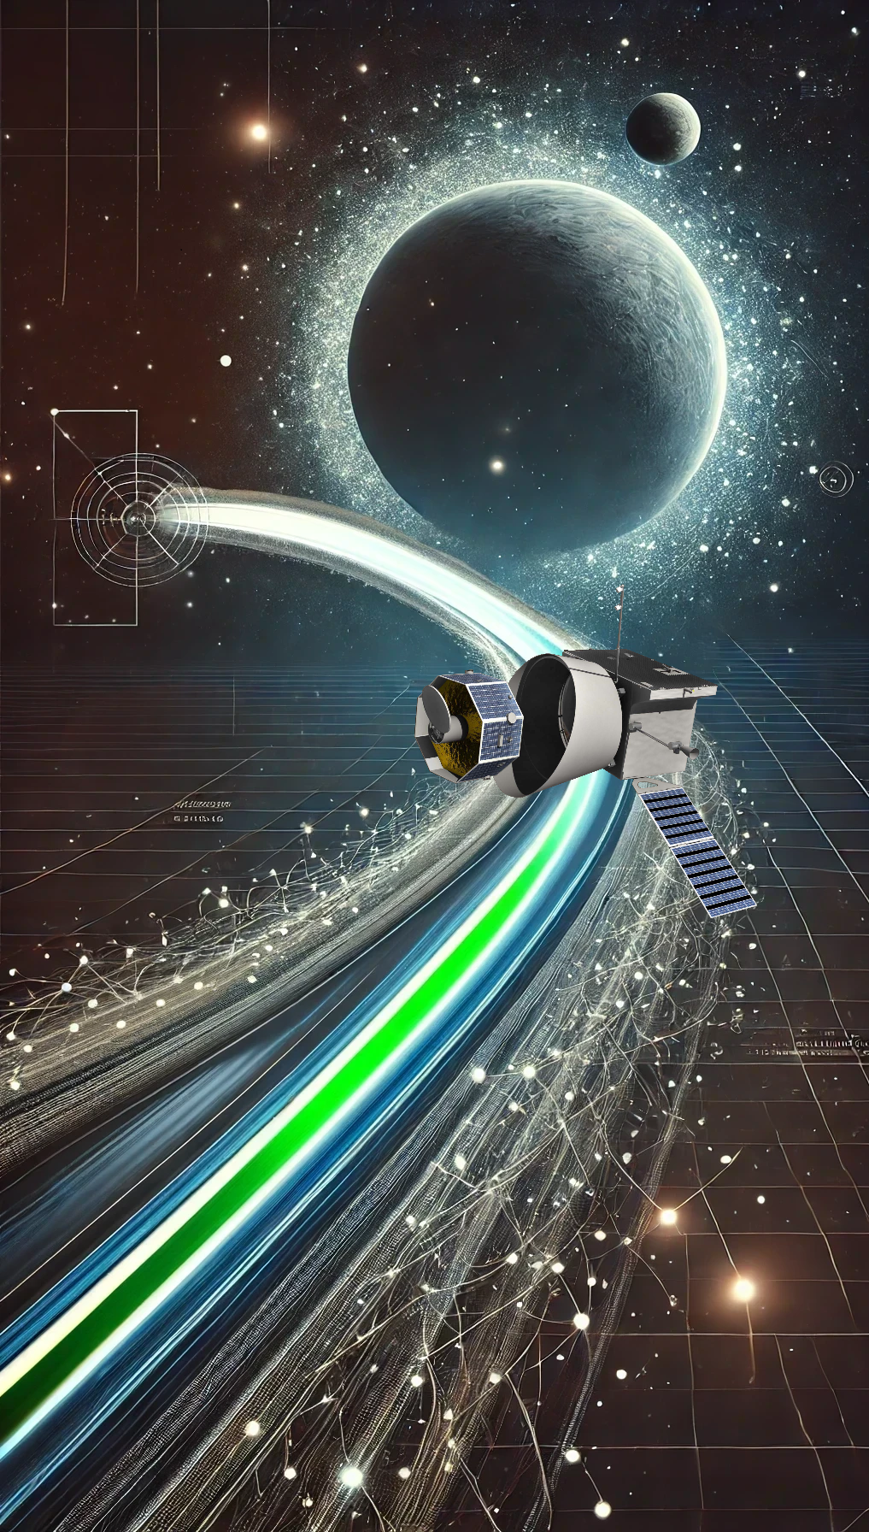
Title slide + image
Physics Constrained Neural Networks for Designing Gravity Assist Trajectories
Master Thesis Midterm Review
Mitchell van Doorn

Slide 2
Contents
Create/edit a Hyperlink TO A SLIDE
1
Go to the tab ‘Insert’ and click on the button ‘Shapes’. Choose the shape ‘Rectangle’ and drag the mouse over the slide to create a shape.
Shapes
2
Drag the shape over the menu button and scale the shape as large as the button. Click with the right mouse button on the shape and choose ‘Edit shape’.
Size and position…
Edit shape…
3
Click on the paint bucket icon, click on ‘Shape Fill’ and drag the ‘Transparency’ slider to 100%. Now the shape is completely transparent.
1
2
3
4
5
Recap Research Proposal
Results so far
Analysis and reflection of results
Updated plan for remainder of thesis
Q&A and Feedback
Transparency
100%
4
Click on the transparent shape and use the shortcut Ctrl + K to add a hyperlink. At the left side of the window, click on ‘Place in this document’ and select the preferred slide in the list. Then click on ‘OK’.
5
Copy the transparent shape and repeat step 4. Do this for all menu buttons.
Want to know more? Go to the tab 'SLIDEBUILDER’ and click on the button ‘Inspiration'
Inspiration

Slide 3
Chapter | dark mode
00
Recap Research Proposal
1

Slide 4
Research questions
Main Research Question:
“How can Physics-Constrained Neural Networks (PCNNs) be effectively utilized to design optimal trajectories involving gravity assist for spacecraft with low-thrust propulsion systems?”
Sub questions:
How can the dynamics of gravity assist trajectories be integrated in PCNNs?
How can PCNNs learn to perform gravity assist maneuvers?
How can suitable neural network architectures be established?
How can the PCNN model be trained effectively?
What are the benefits and limitations of using PCNNs for optimizing low-thrust gravity assists trajectories?

Slide 5
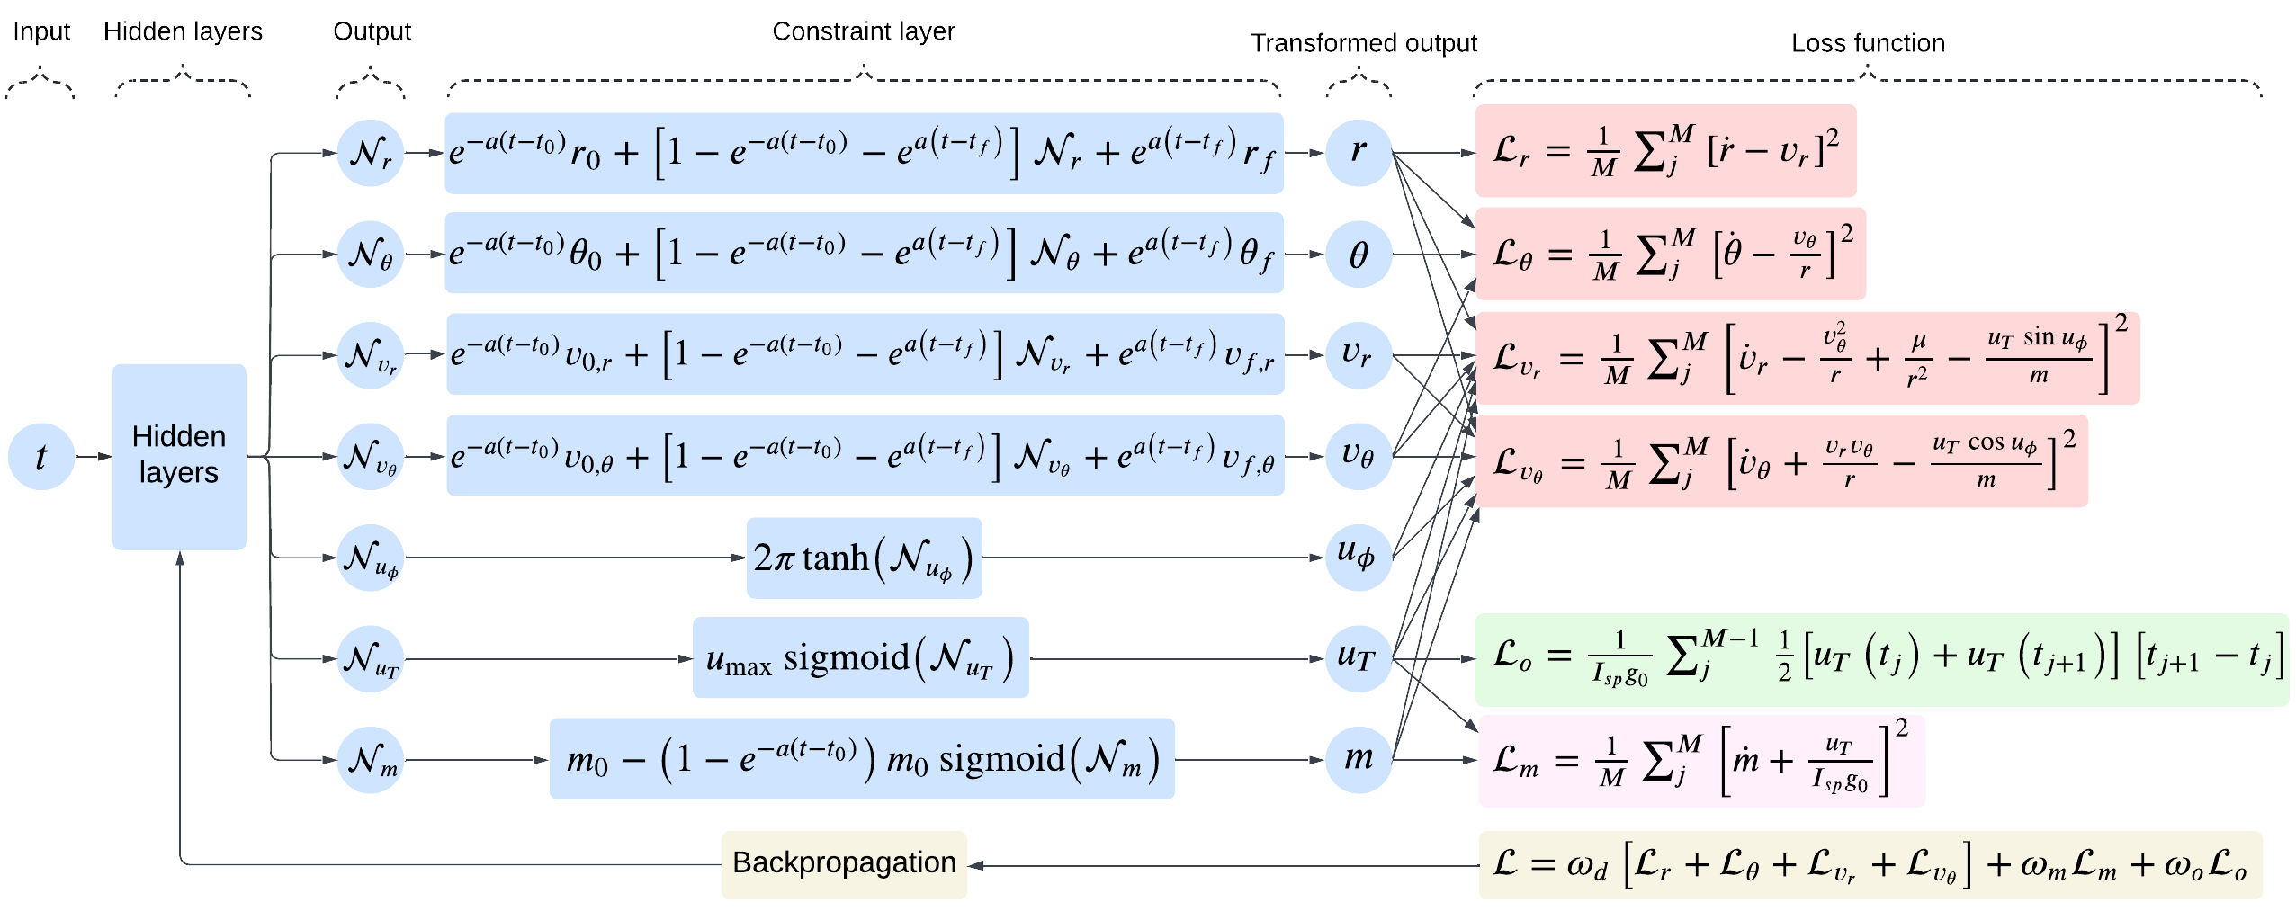
Basic PCNN design

Slide 6
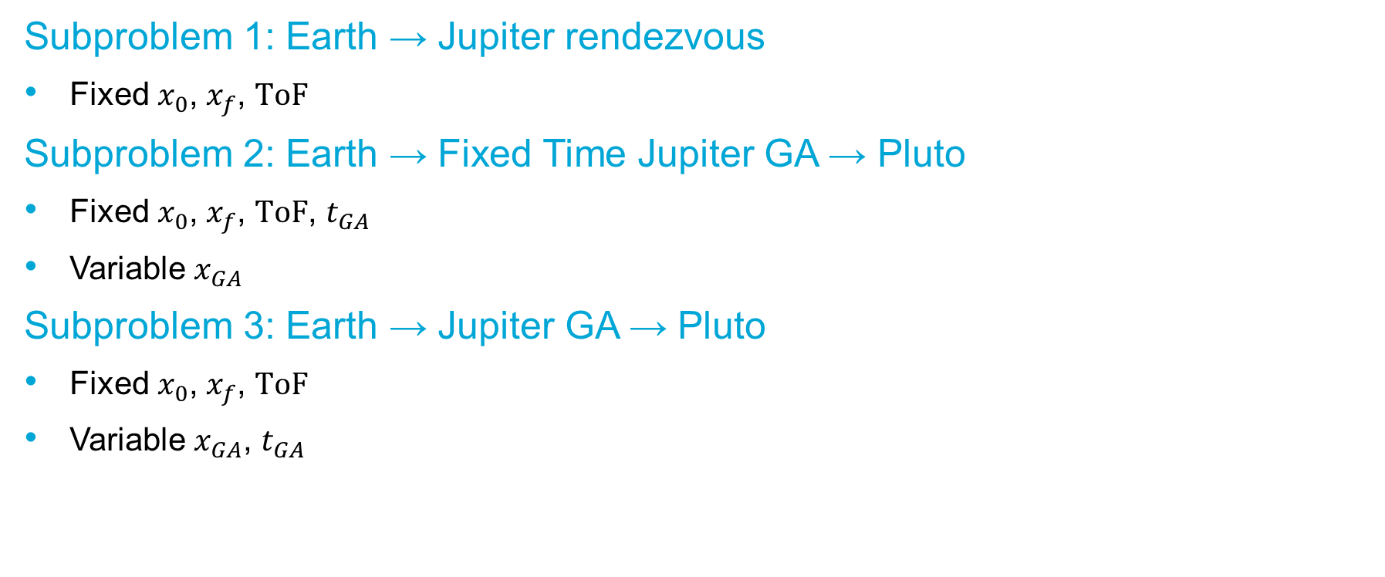
Subproblems to be solved
Subproblem 1: Earth → Jupiter rendezvous
Fixed $x_{0}$, $x_{f}$, $ToF$
Subproblem 2: Earth → Fixed Time Jupiter GA → Pluto
Fixed $x_{0}$, $x_{f}$, $ToF$, $t_{GA}$
Variable $x_{GA}$
Subproblem 3: Earth → Jupiter GA → Pluto
Fixed $x_{0}$, $x_{f}$, $ToF$
Variable $x_{GA}$, $t_{GA}$

Slide 7
Chapter | dark mode
00
2
Results so far

Slide 8

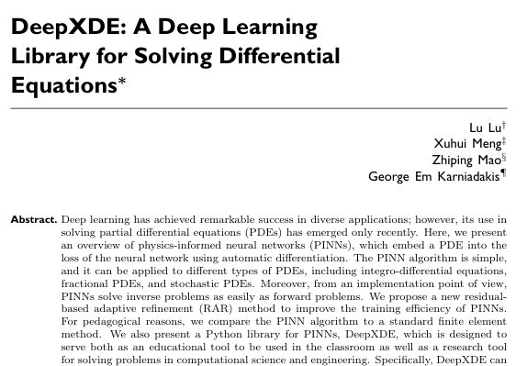
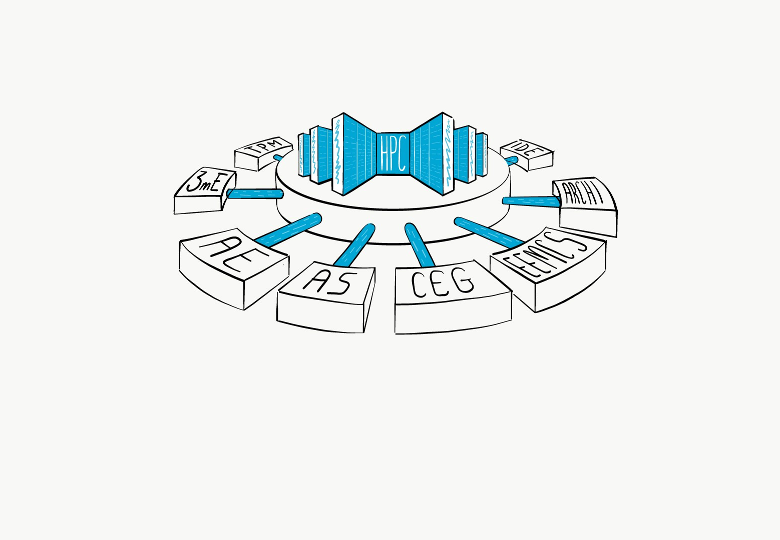
Software/hardware Exploration
TensorFlow
DeepXDE
Delft Blue
The TU Delft supercomputer

Slide 9
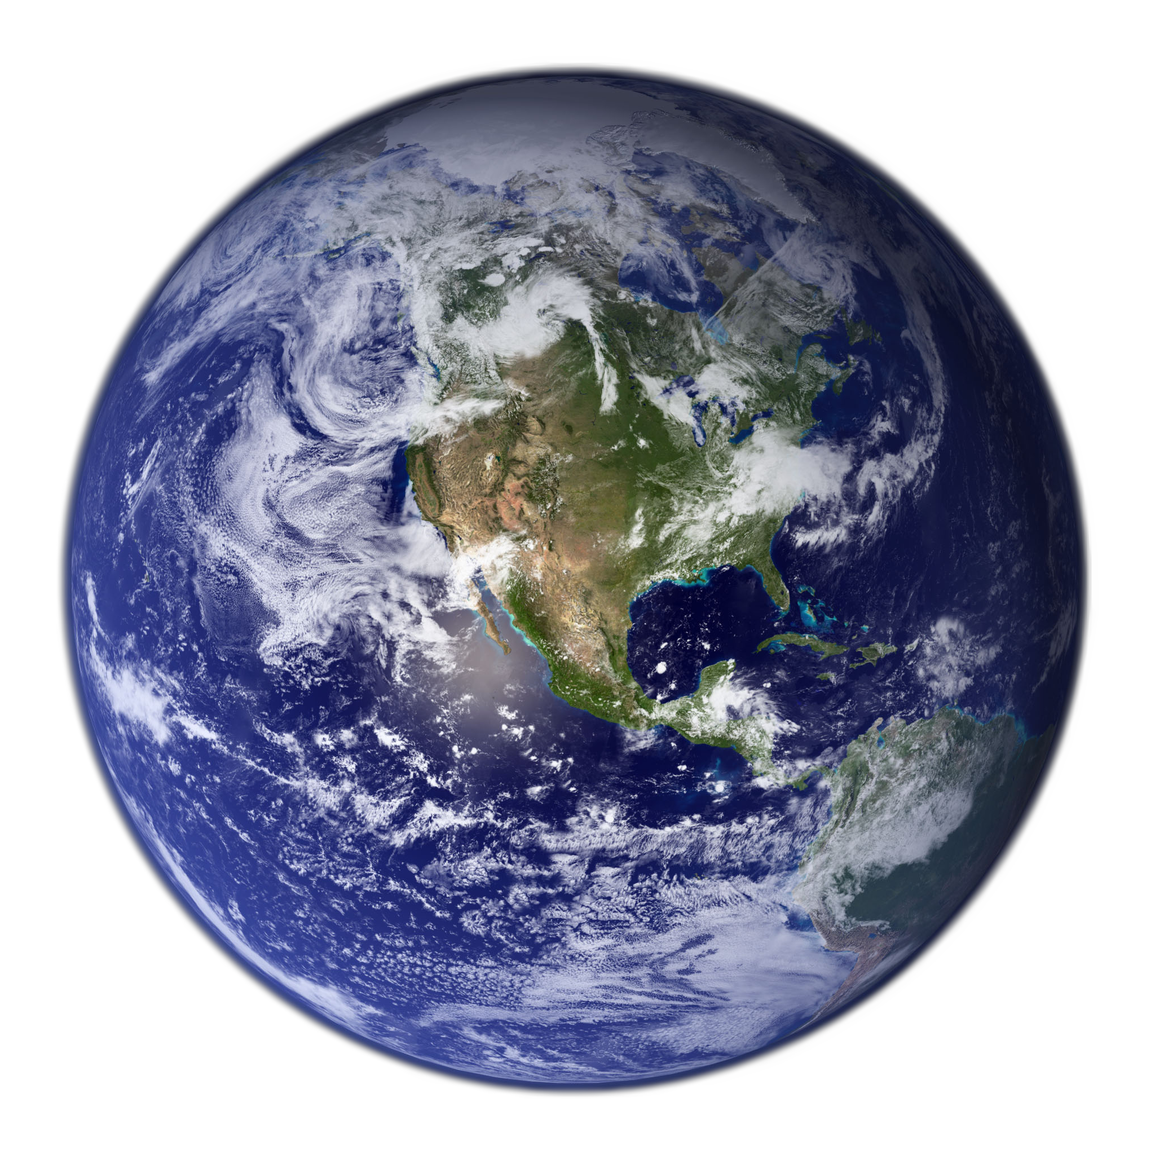
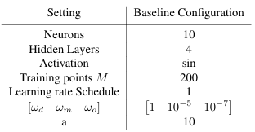
Basic PCNN implementation
1
2
3
Toy problem:
Circular Earth orbit (500km altitude)
4
NN supervised
NN supervised + constraint layer
NN unsupervised + constraint layer + custom loss function (dynamics only)
NN unsupervised + constraint layer + custom loss function (dynamics + objective + mass)
20 5

Slide 10
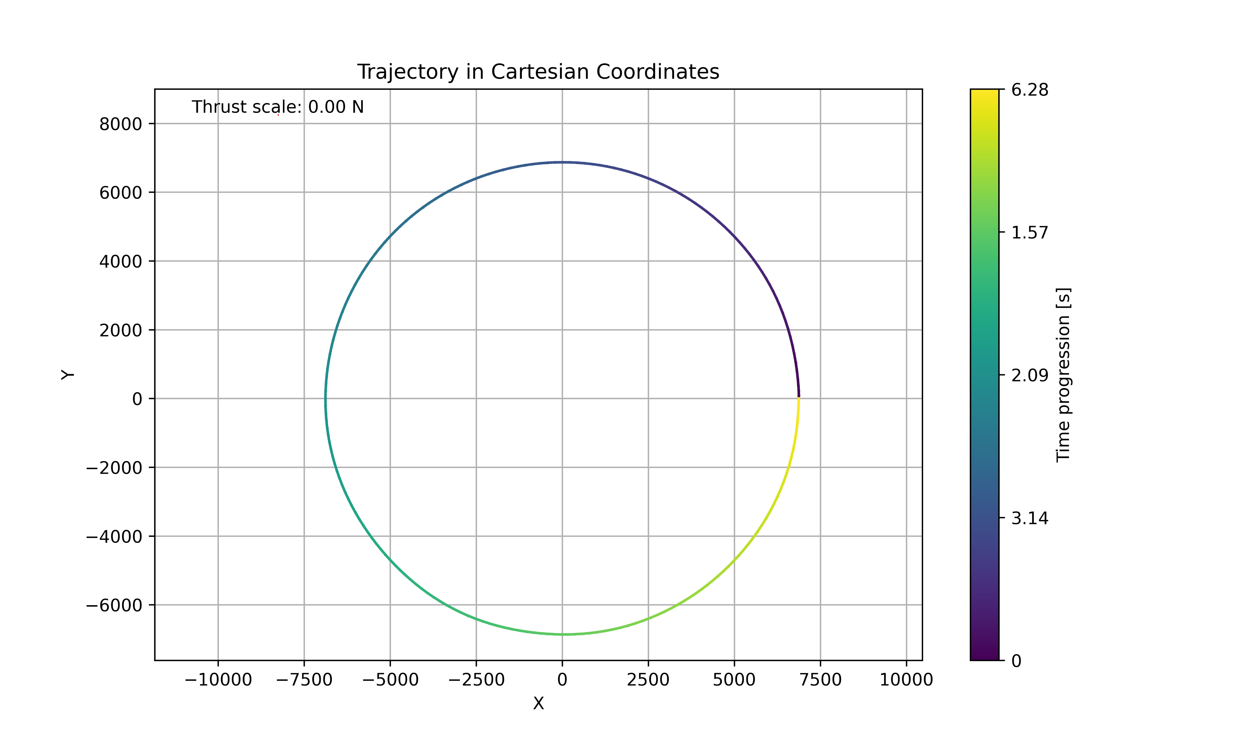
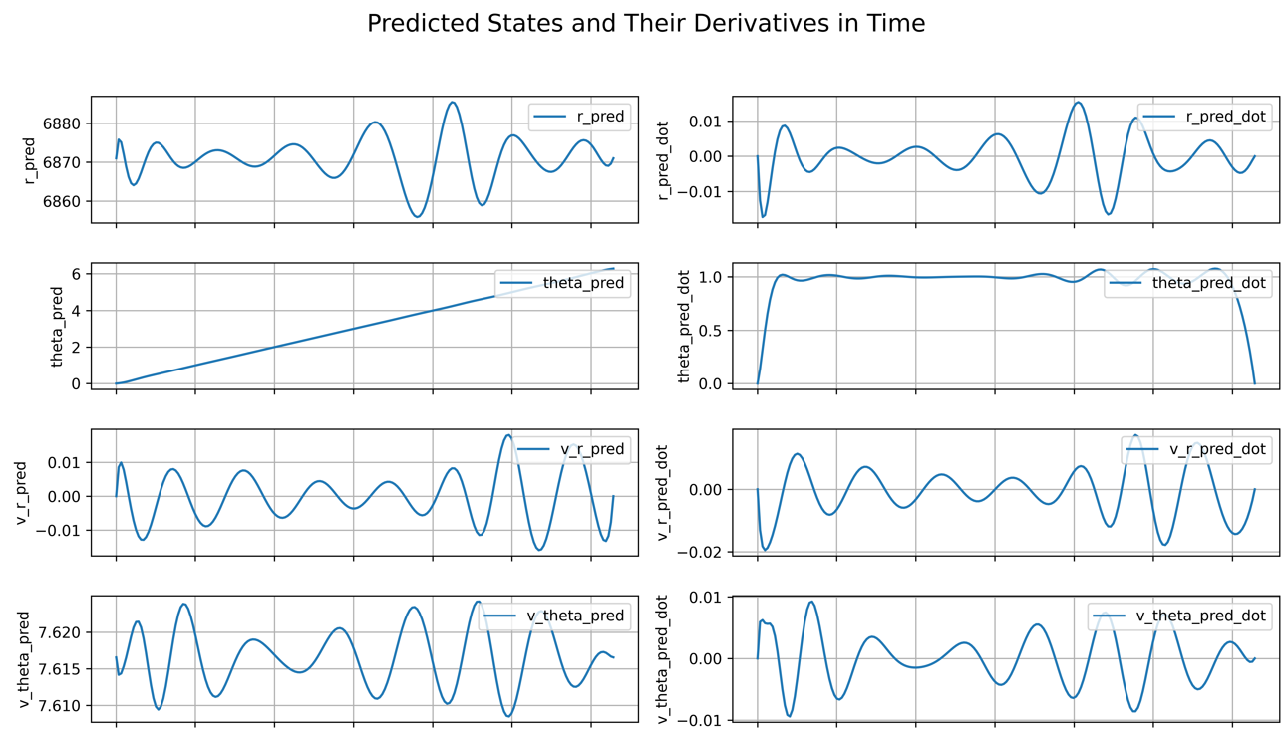
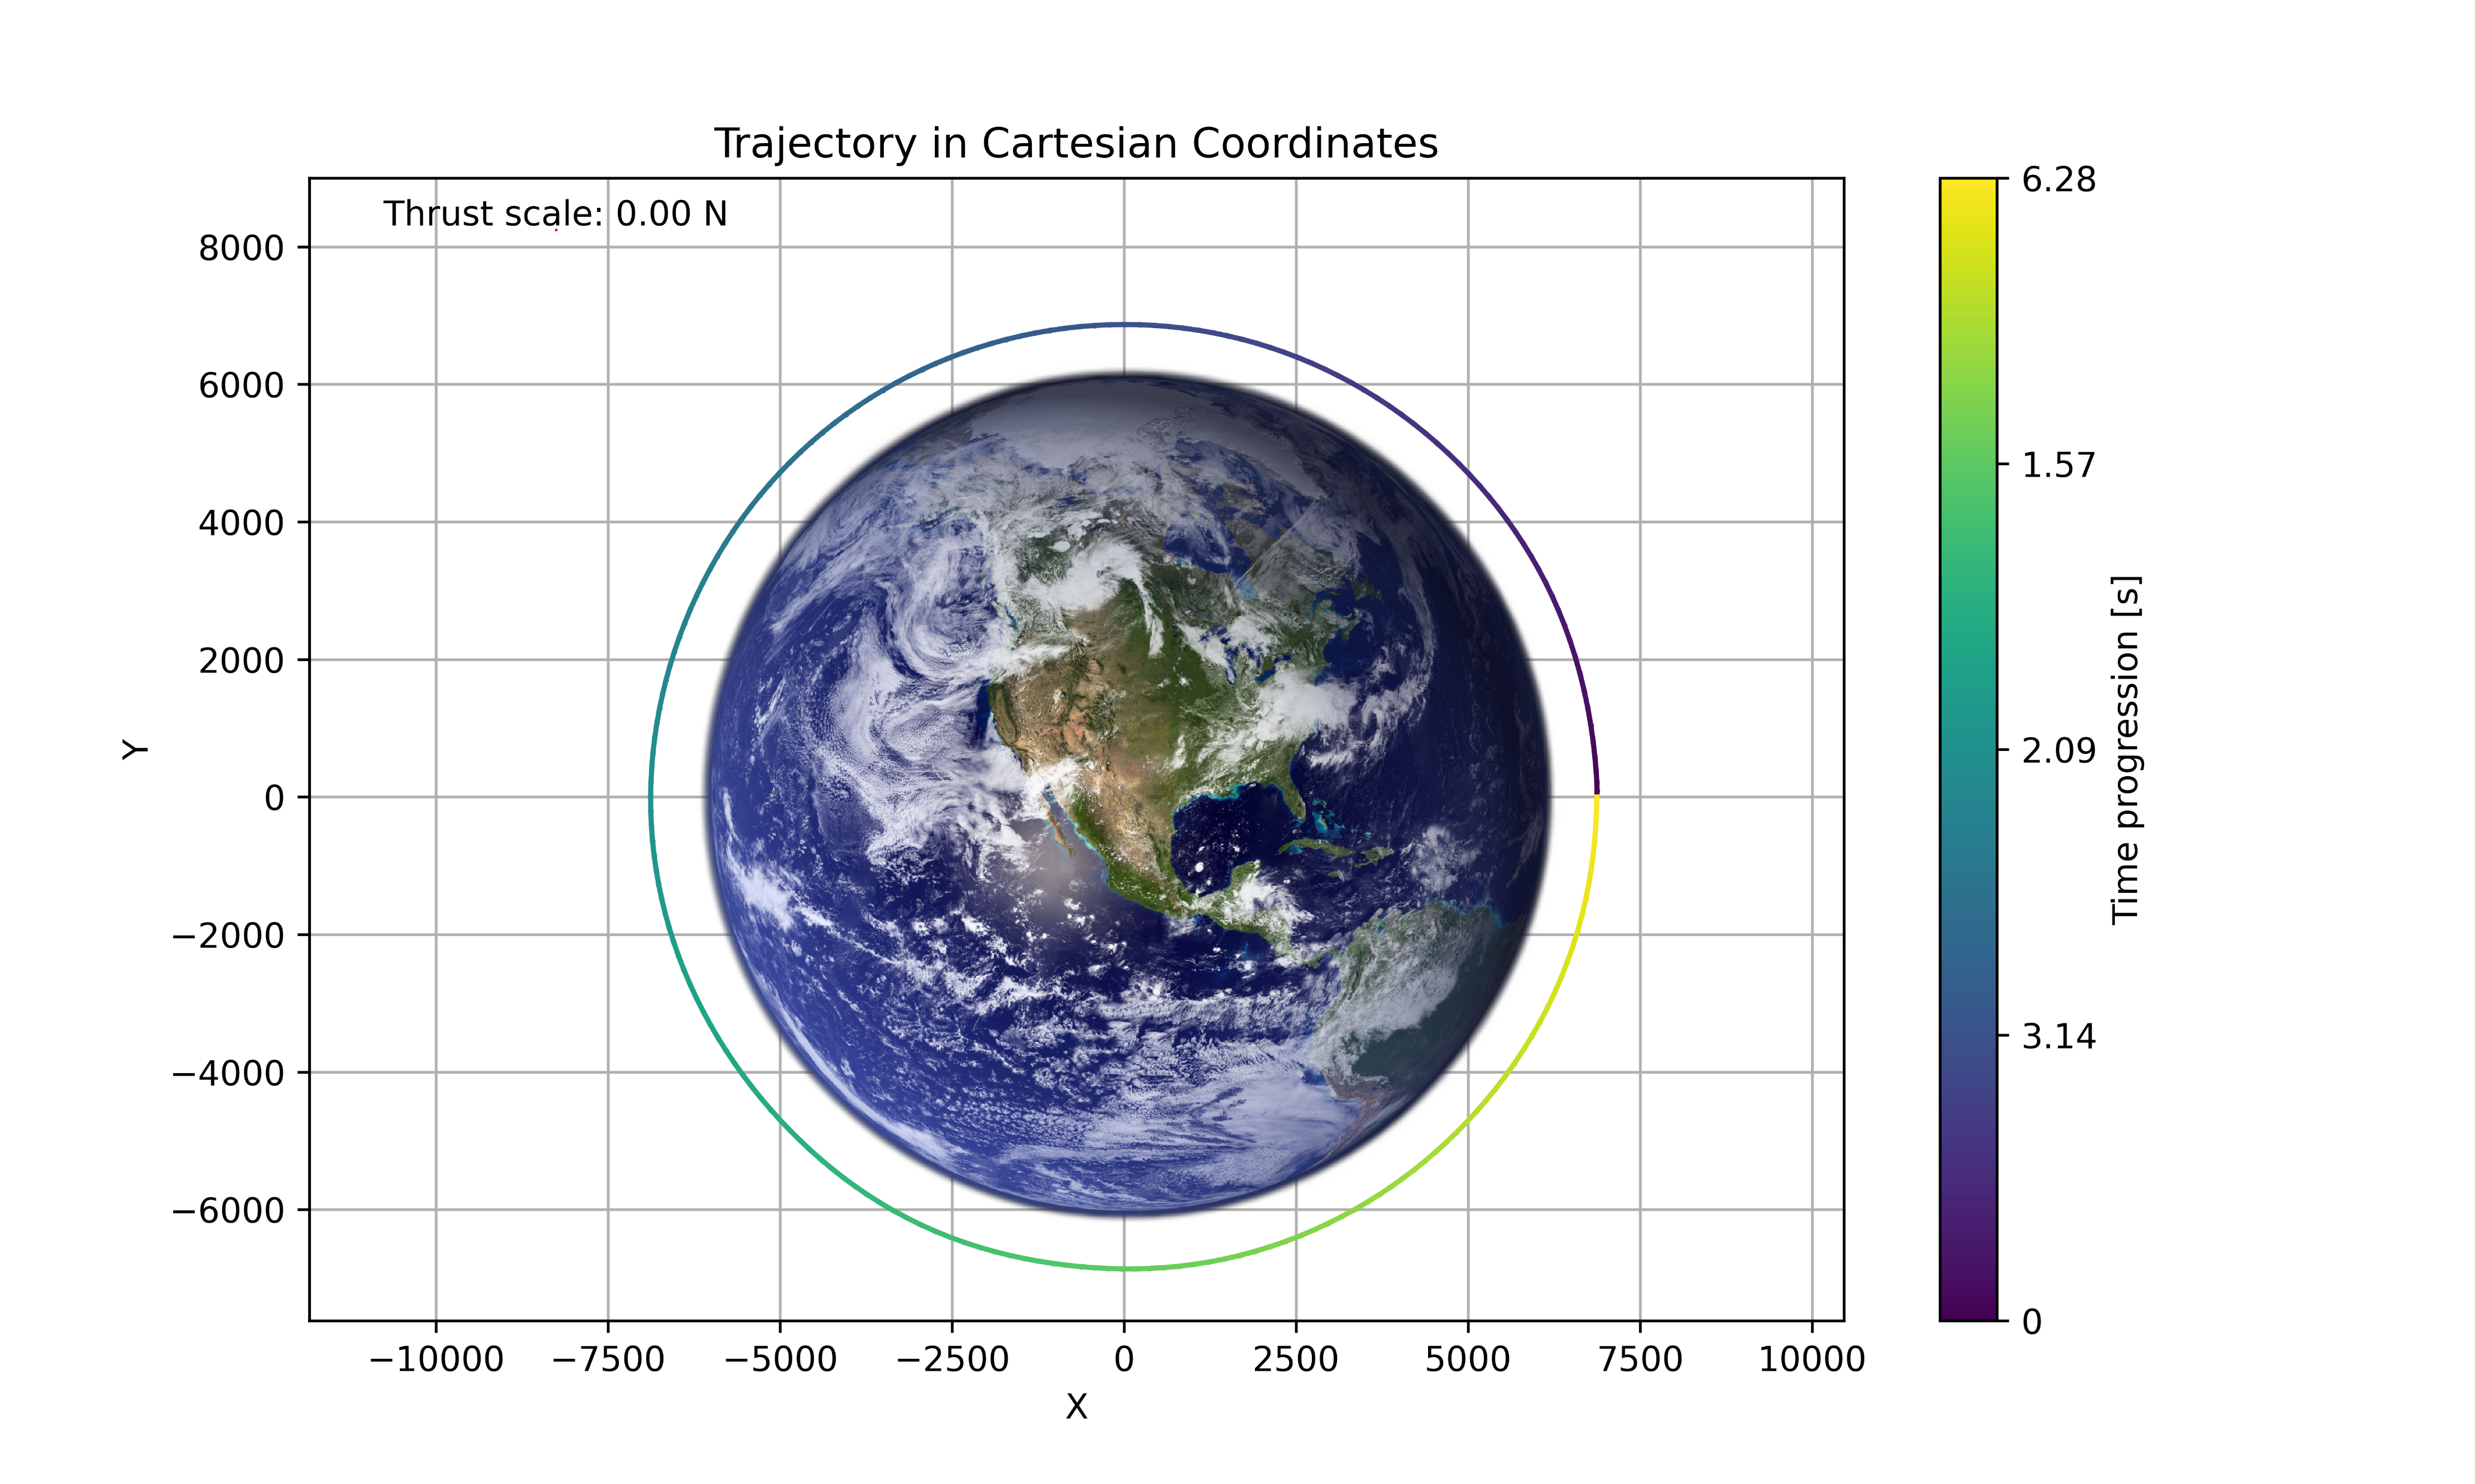
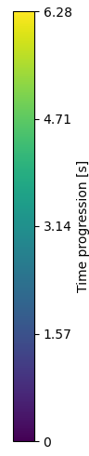
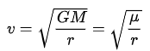
Results
NN supervised
NN supervised + constraint layer

Slide 11
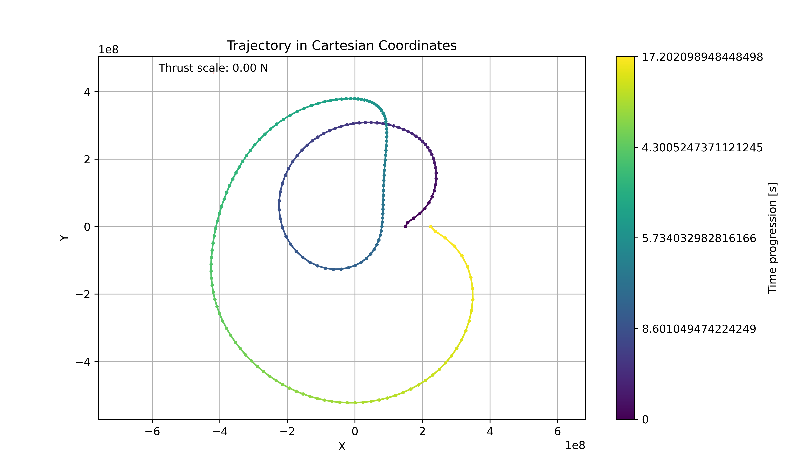
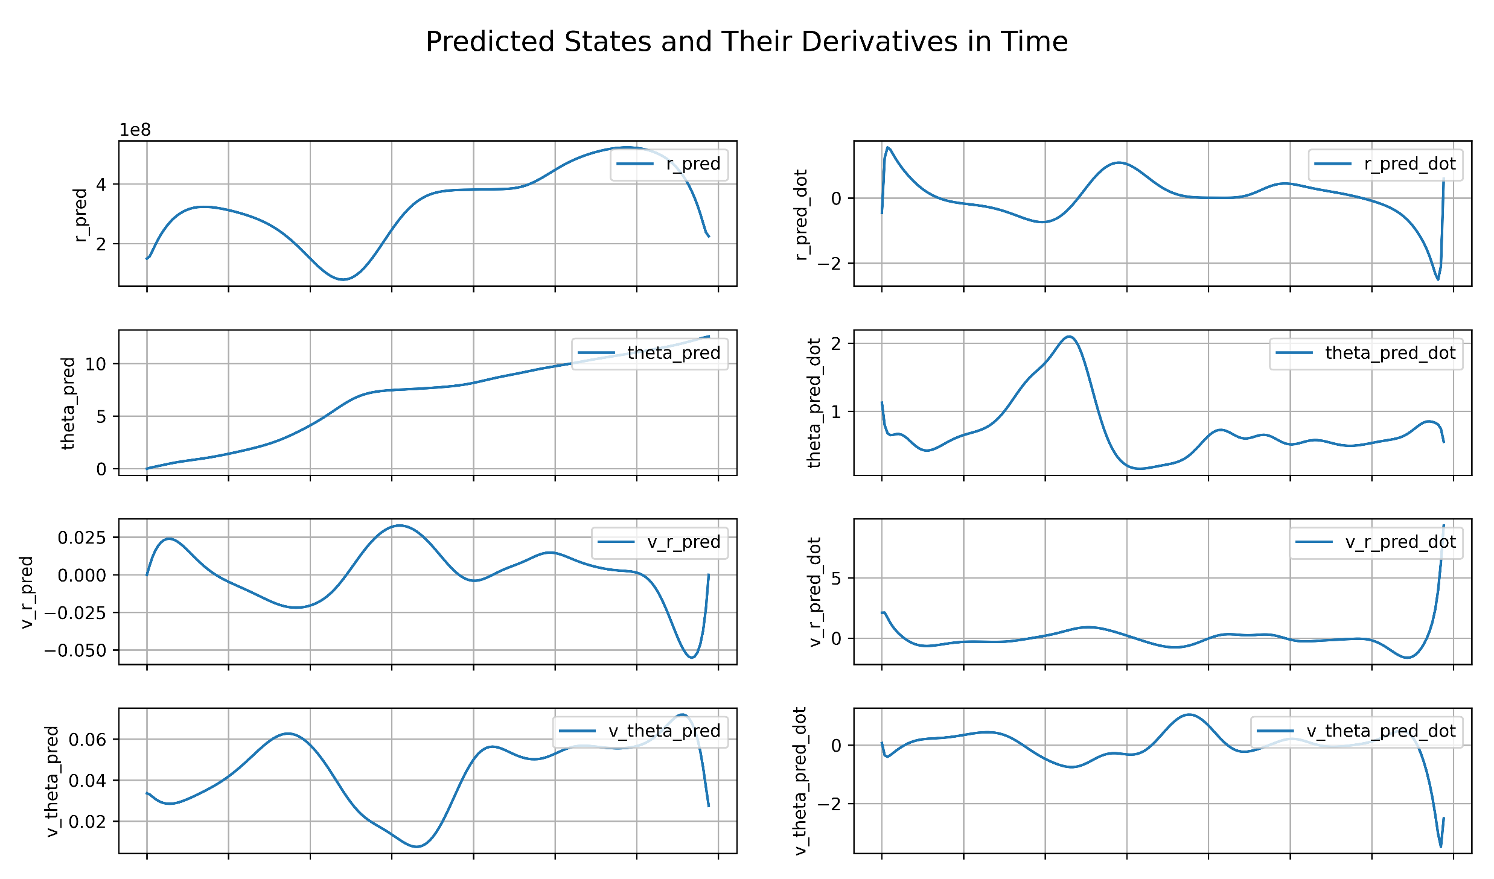
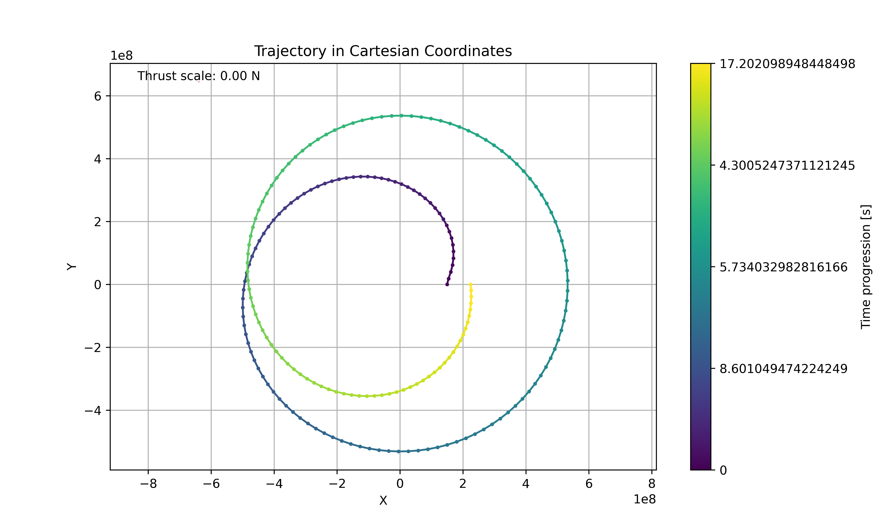
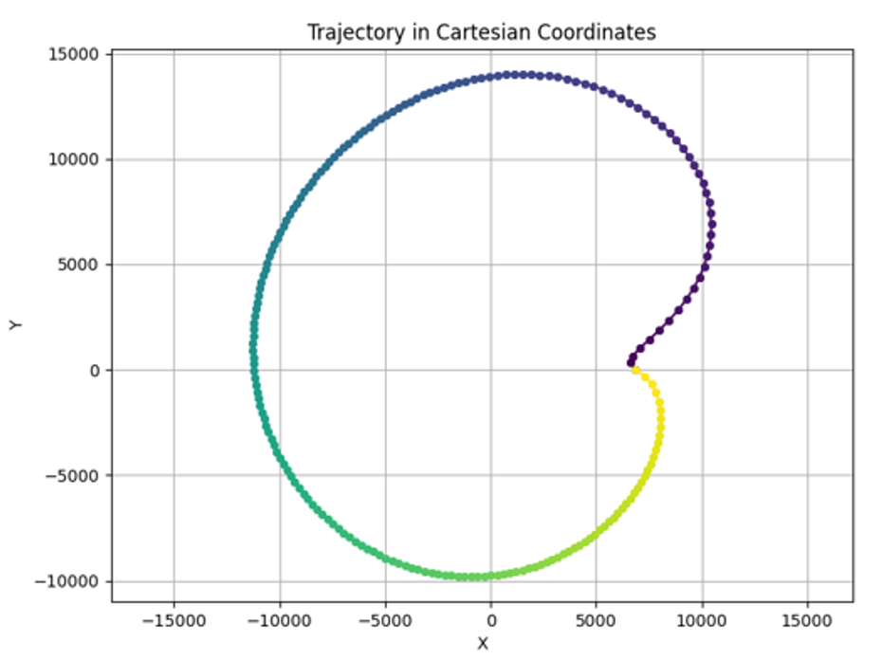
Results
NN unsupervised + constraint layer + custom loss function (dynamics only)
NN unsupervised + constraint layer + custom loss function (dynamics + objective + mass)

Slide 12
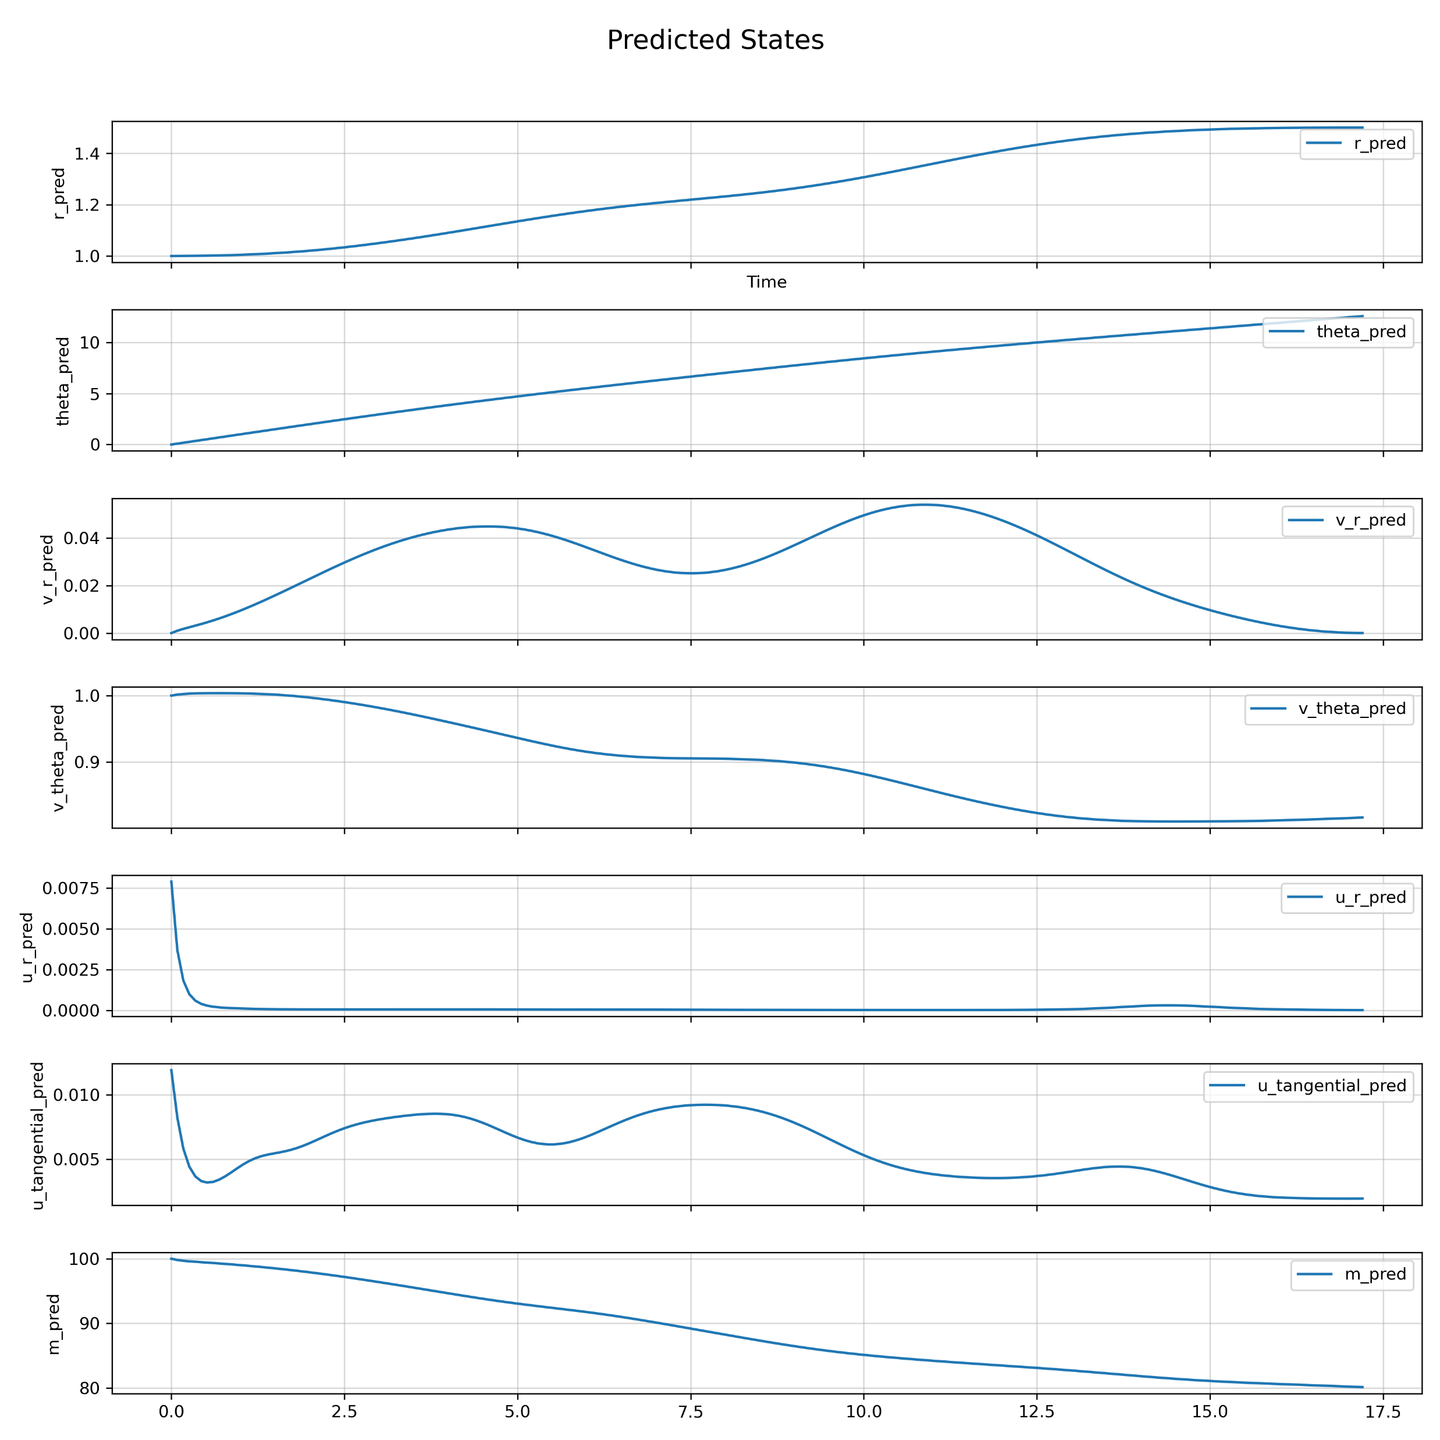
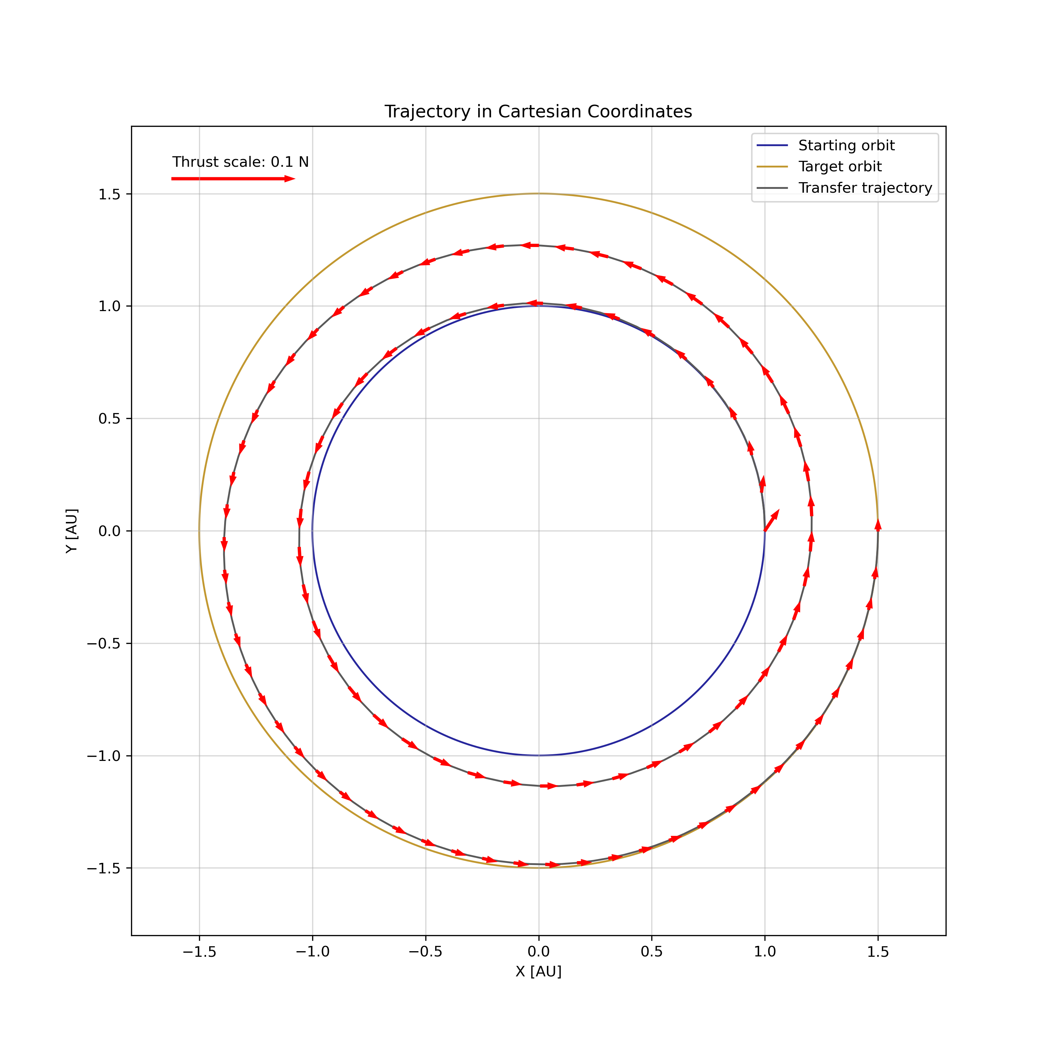
Results with DeepXDE - Trajectory

Slide 13
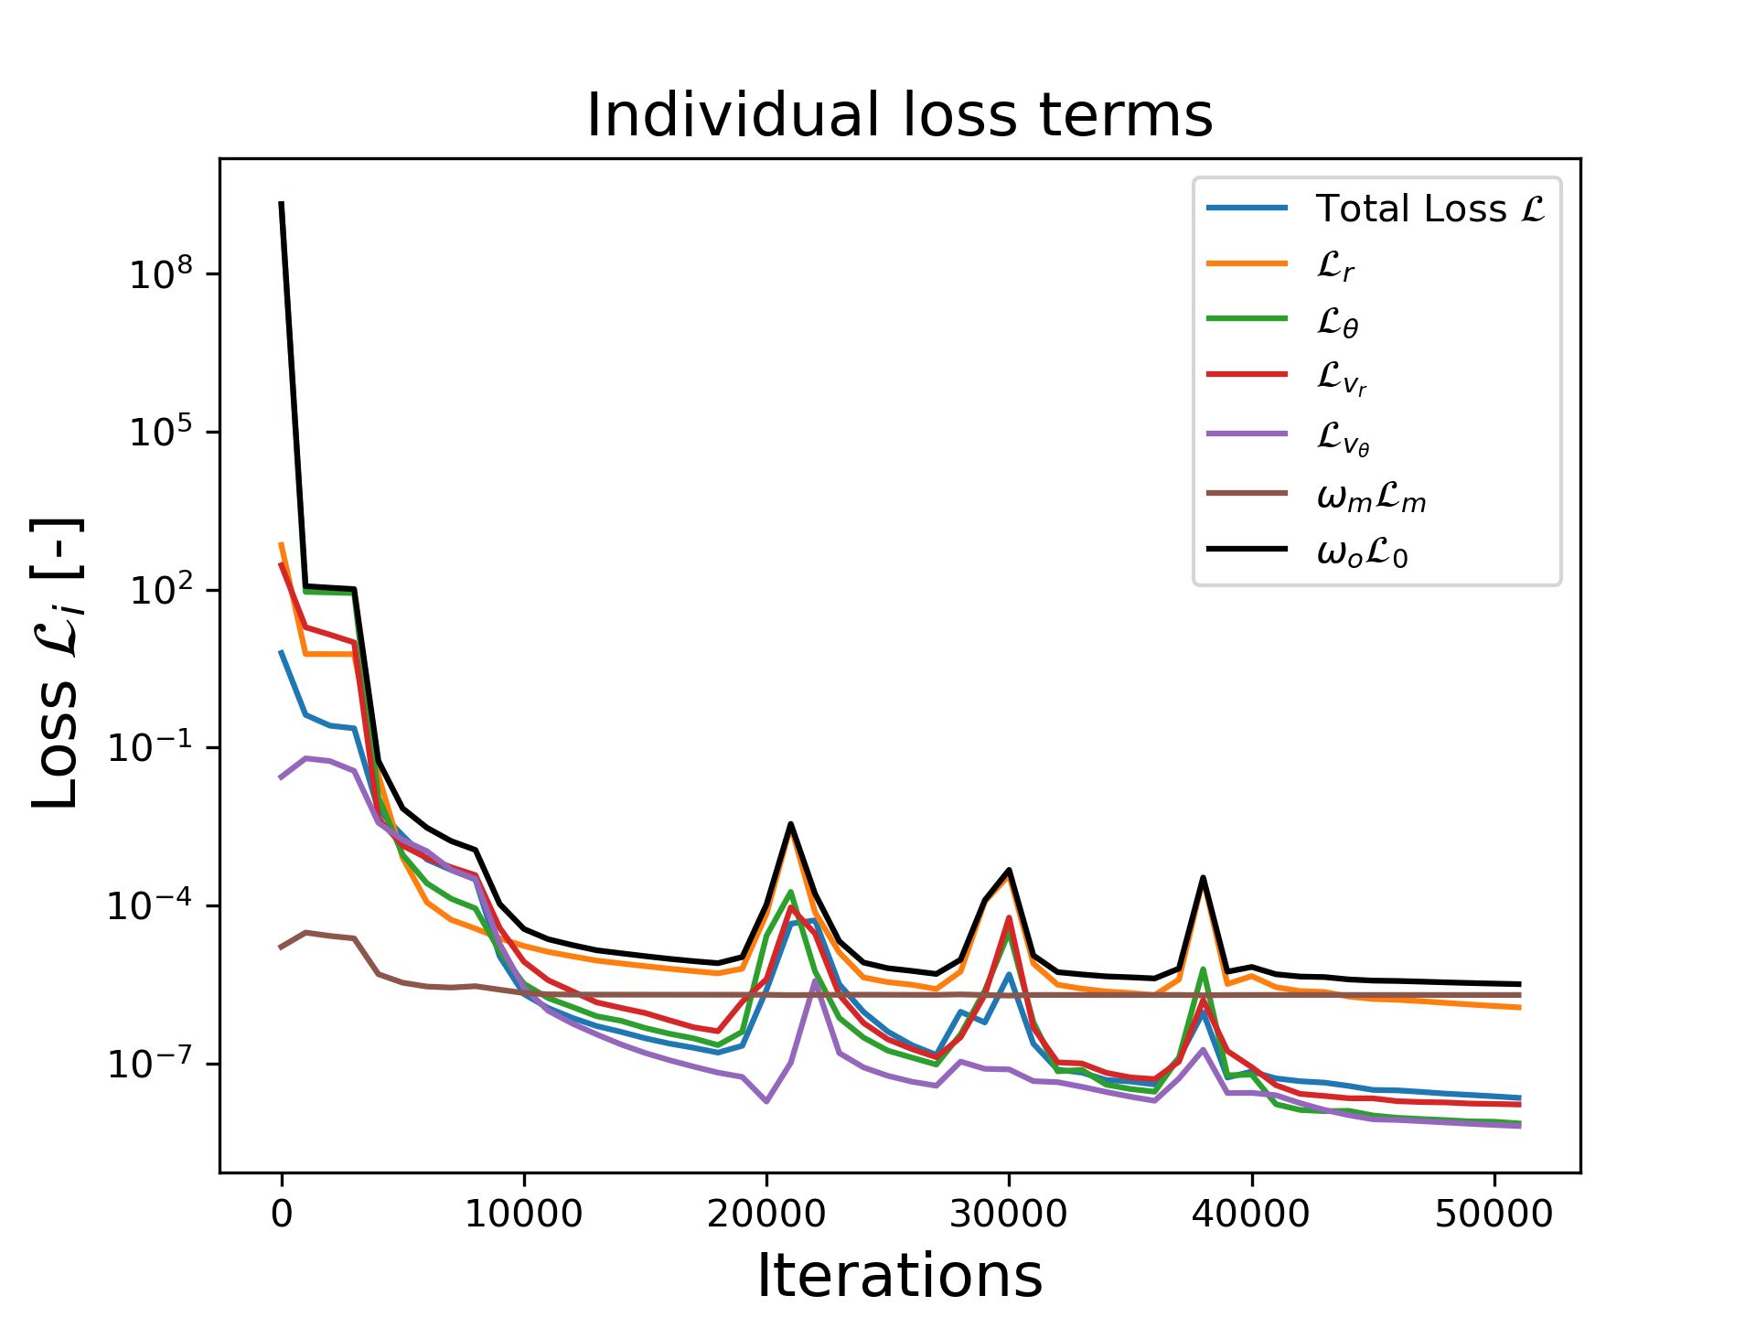
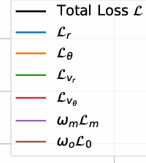
Results with DeepXDE – Loss evolution

Slide 14
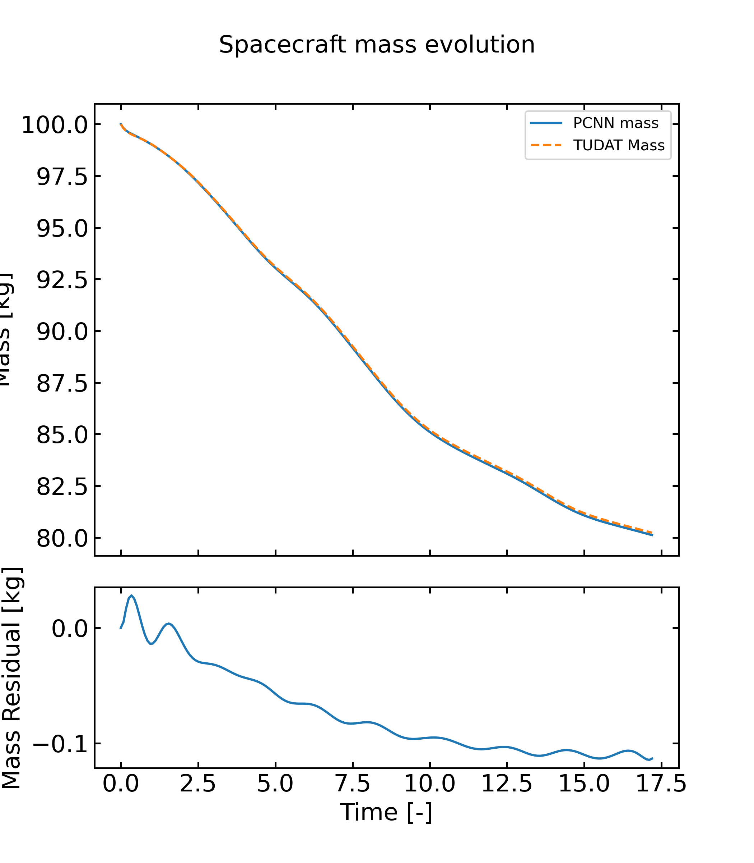
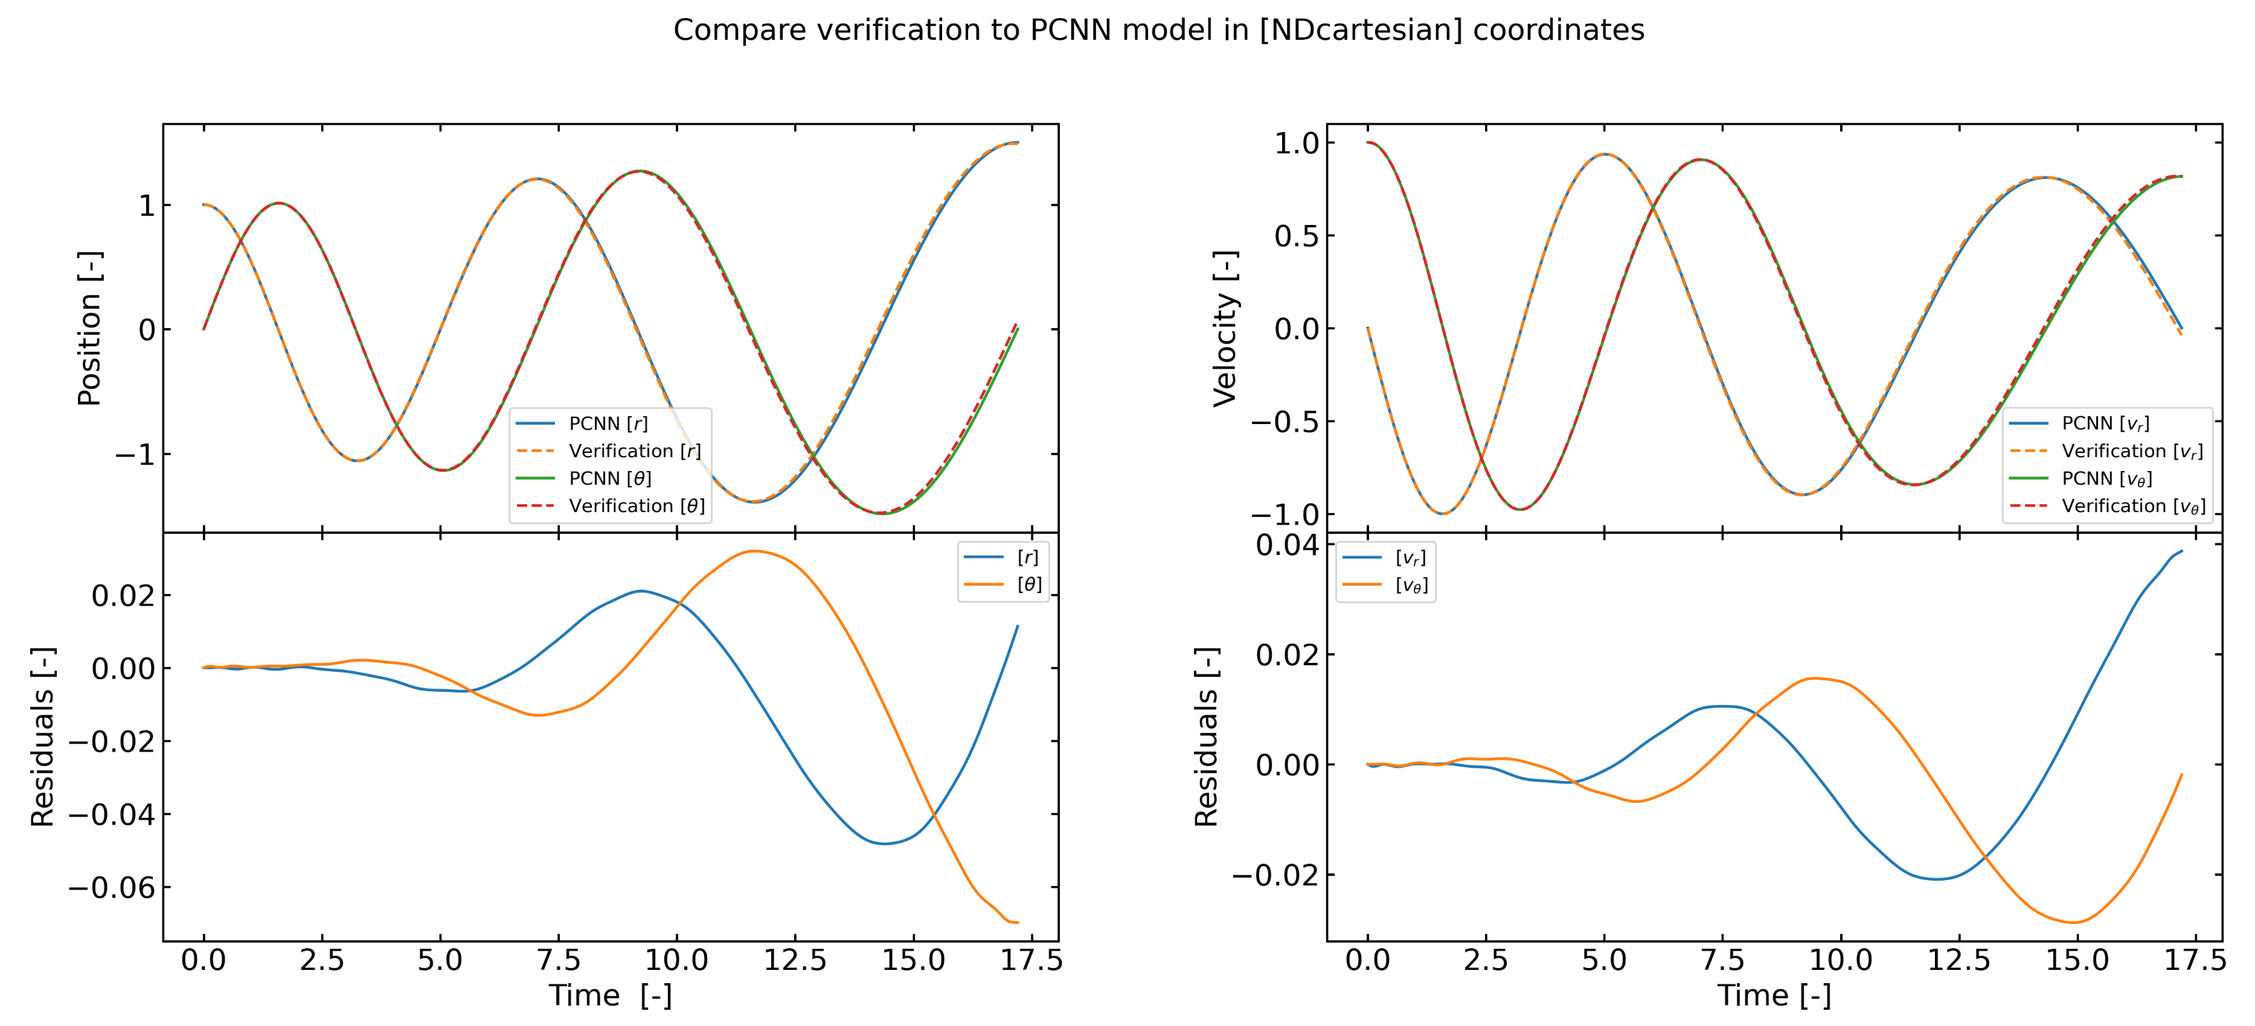
Results with DeepXDE – Comparison with Tudat
Numerical integrator used:
Runge-Kutta 7(8) variable step-size integrator
Rel. & abs. tolerances: 10e-10

Slide 15
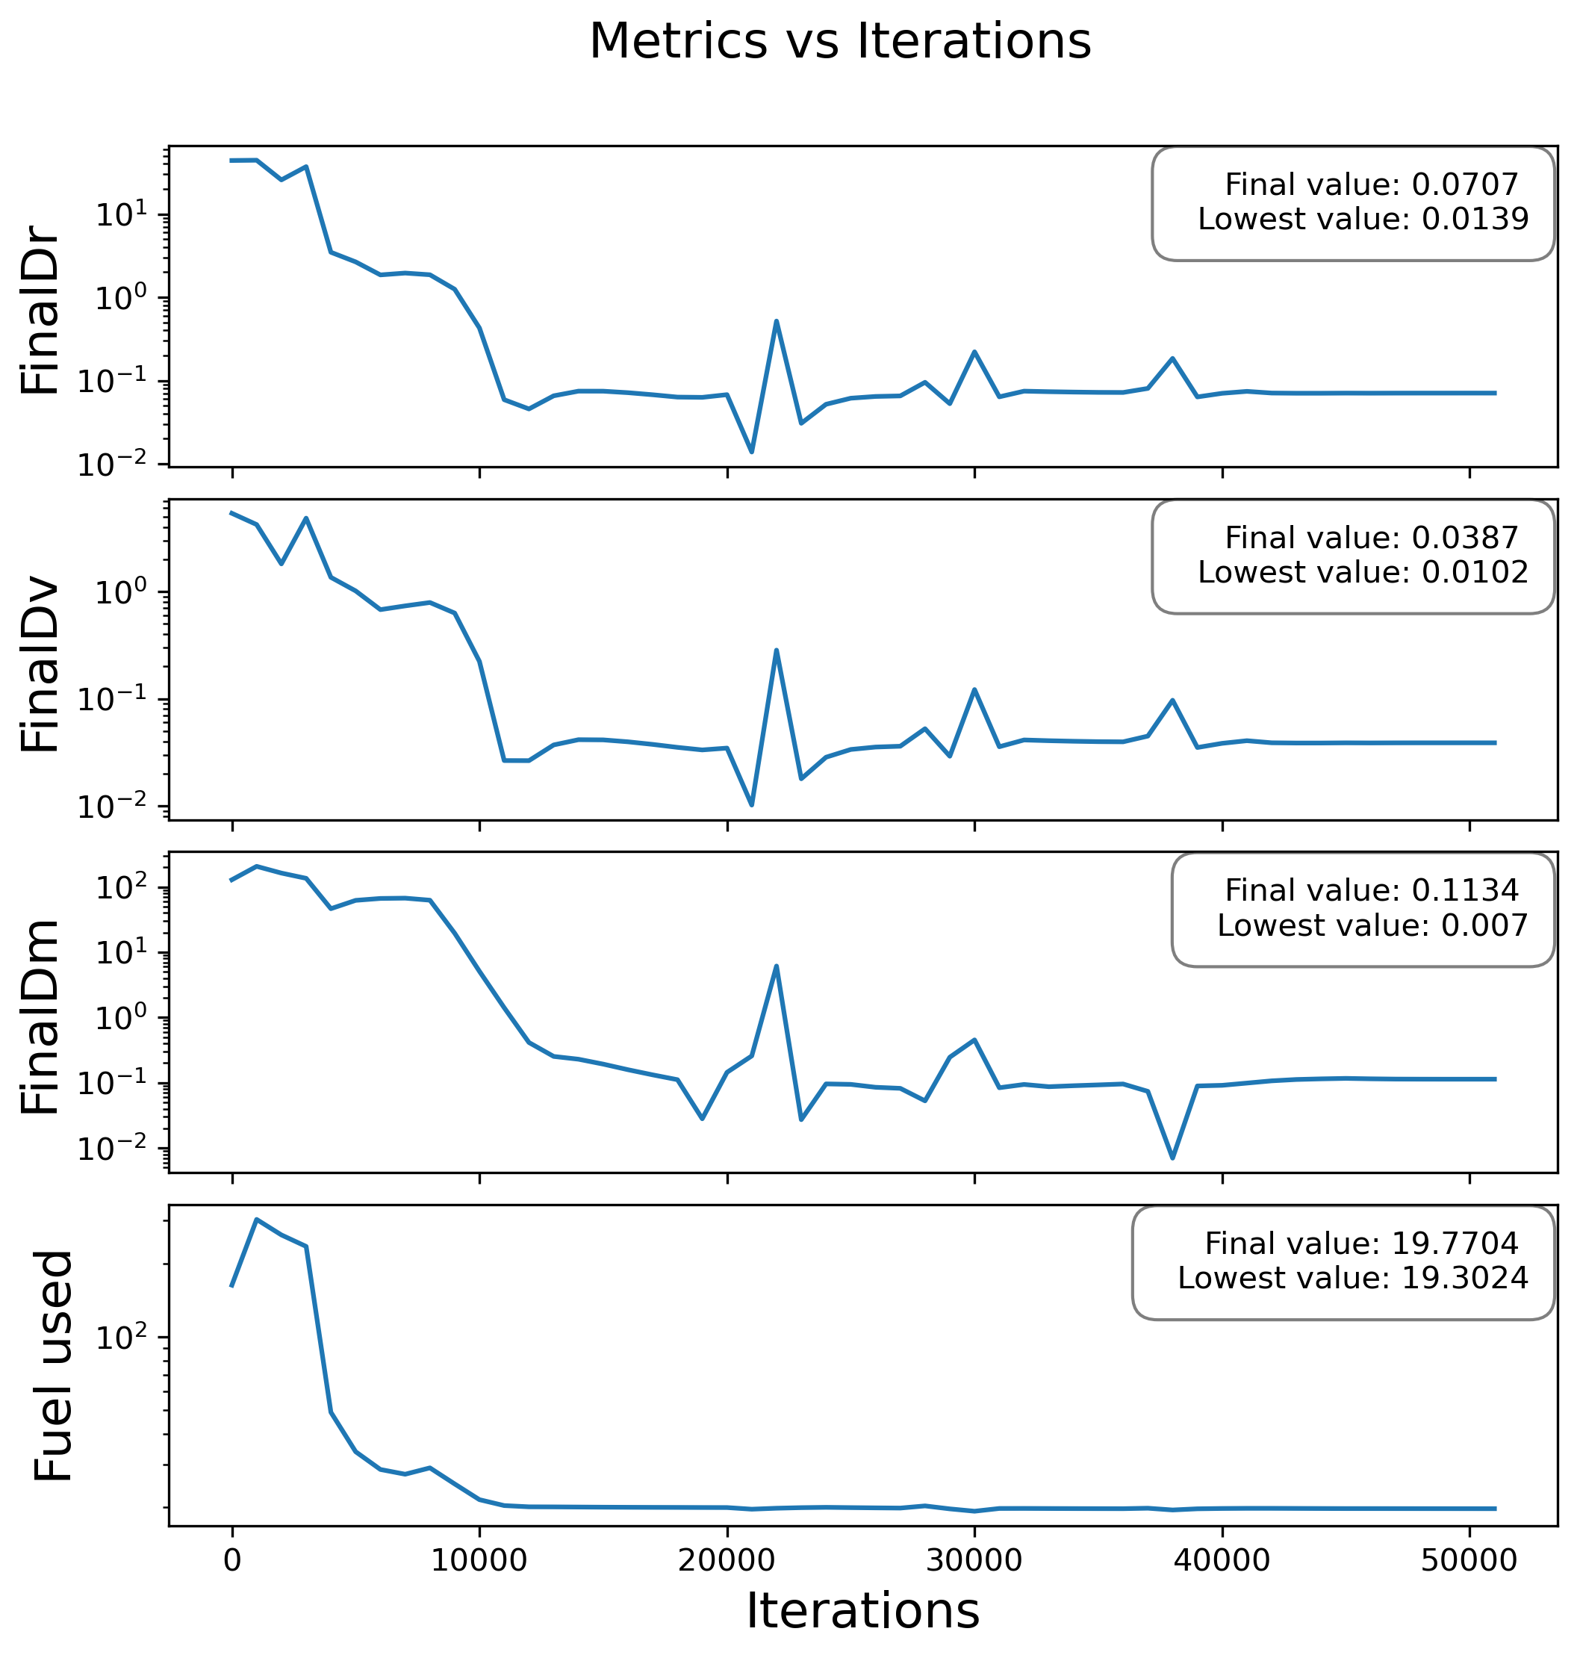
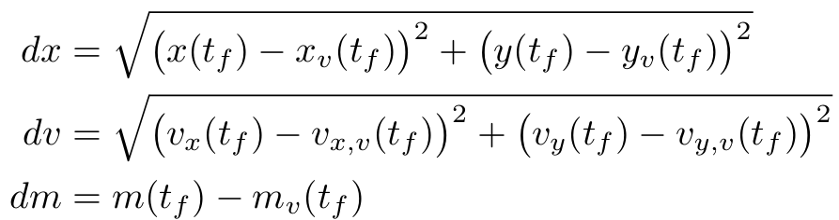
Results with DeepXDE – Metrics

Slide 16
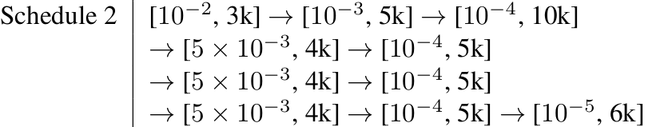
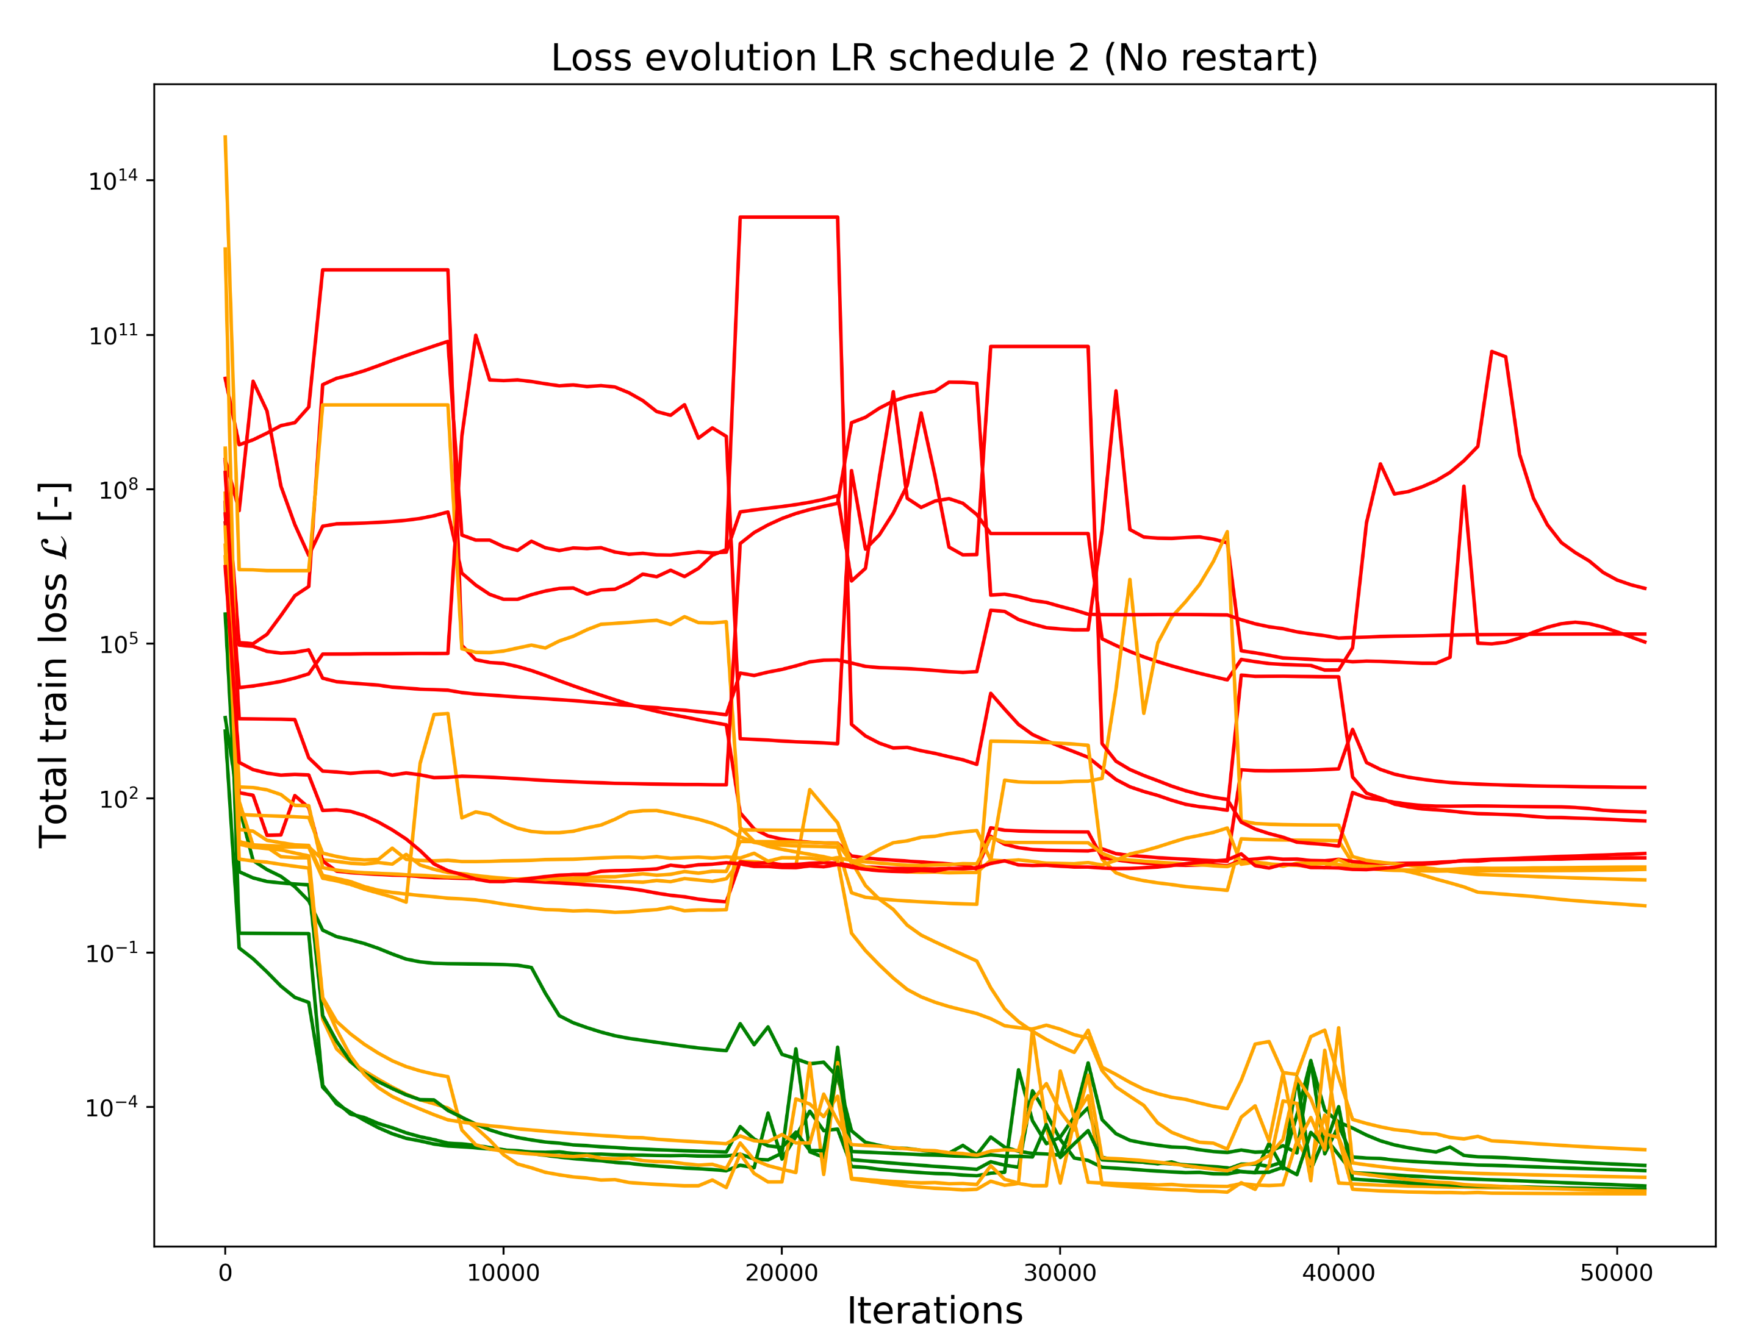
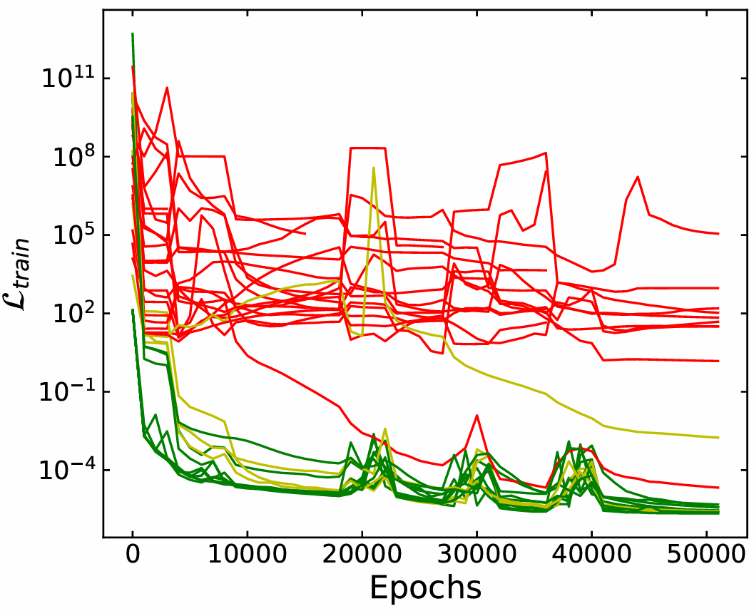
Verification & Validation
Loss evolutions
This work
Goldman’s work

Slide 17
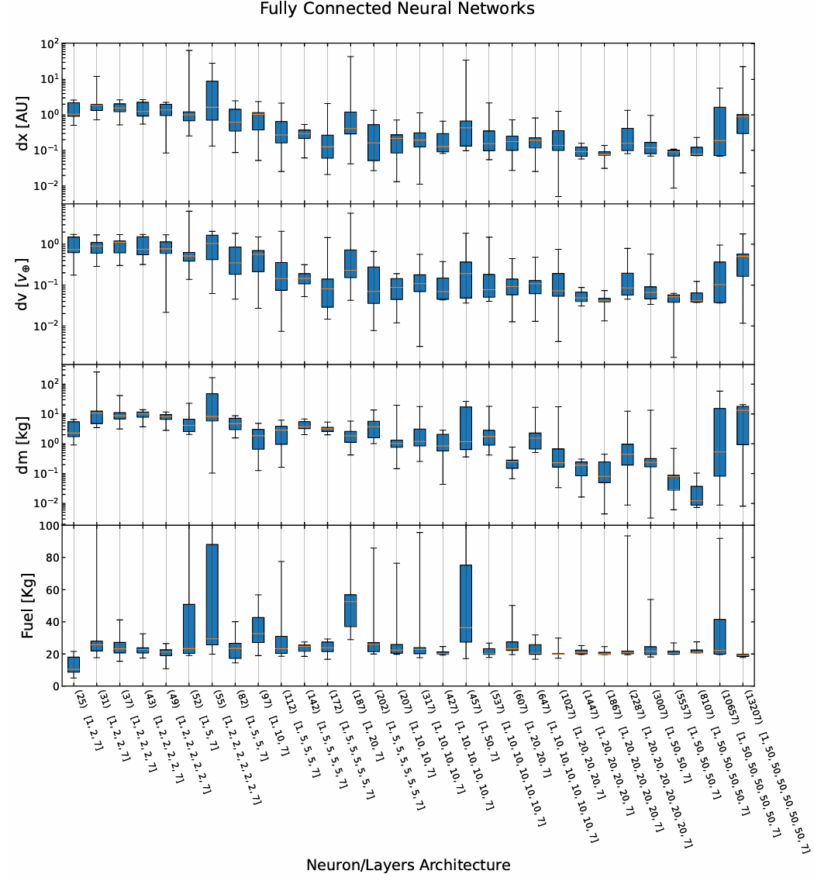
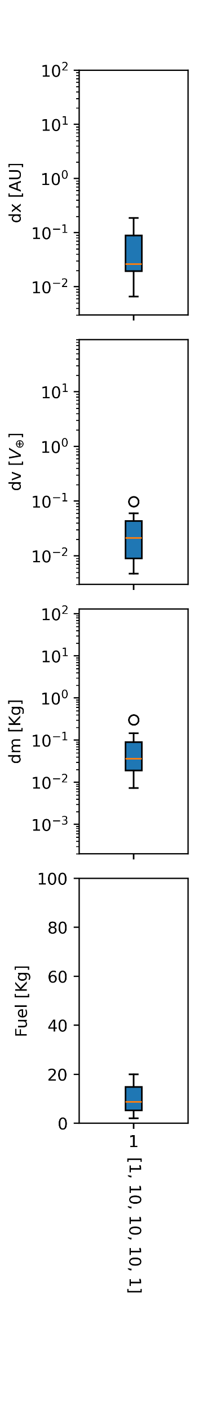
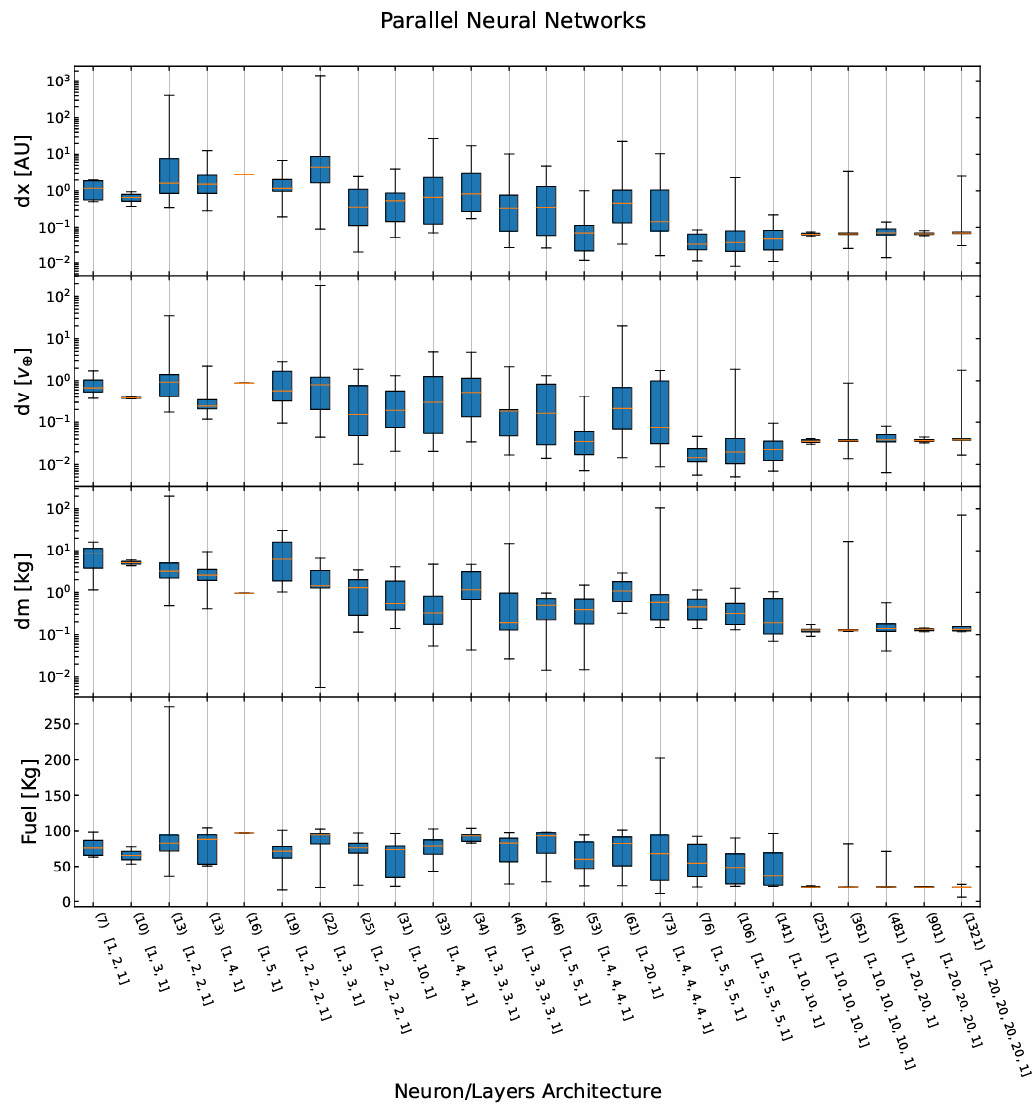
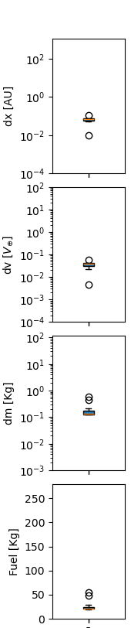
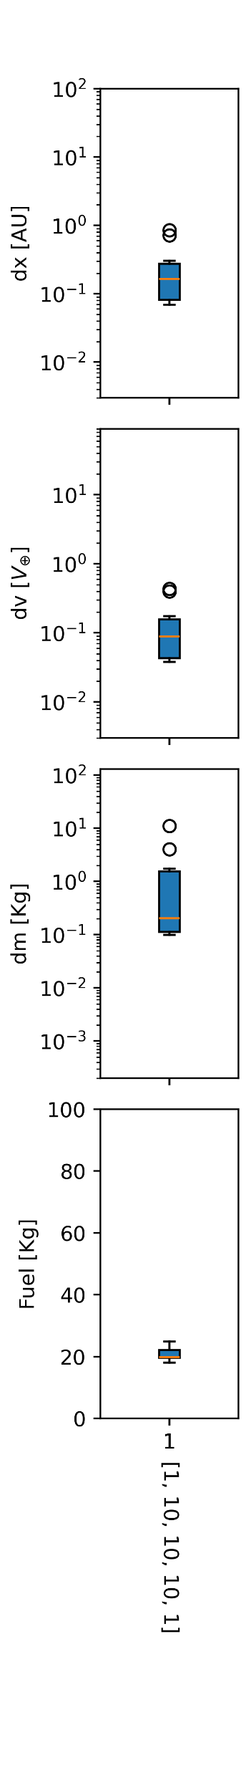
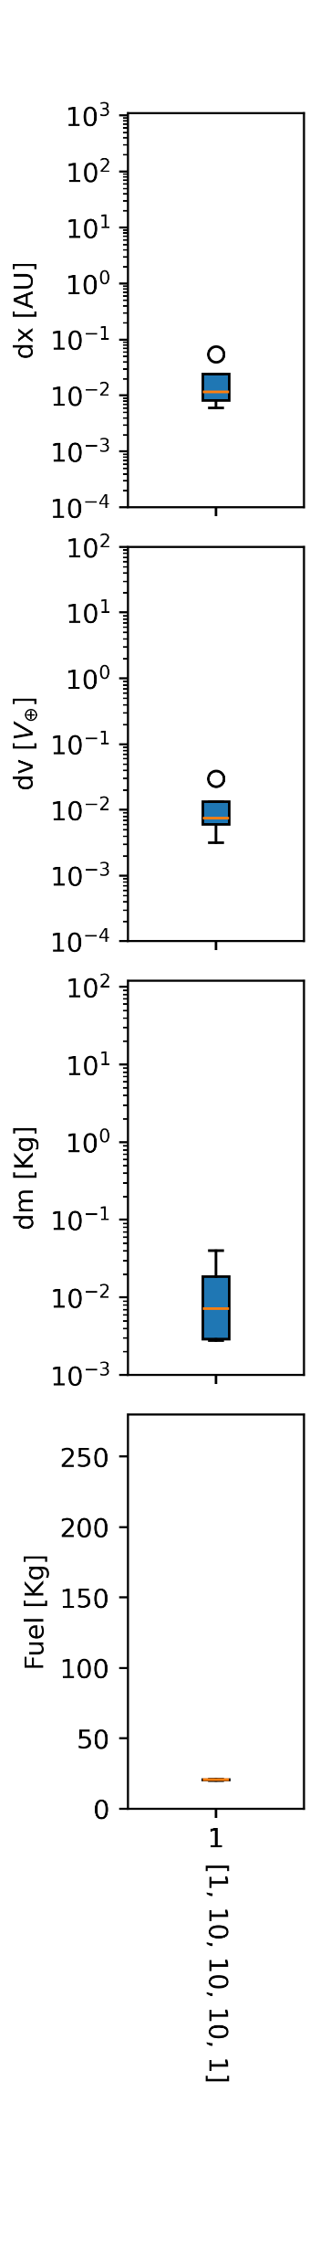
Verification & Validation
Metrics
Fully connected NNs Bundle of 7 parallel NNs
This work
This work
This work
[Goldman]
[Goldman]

Slide 18
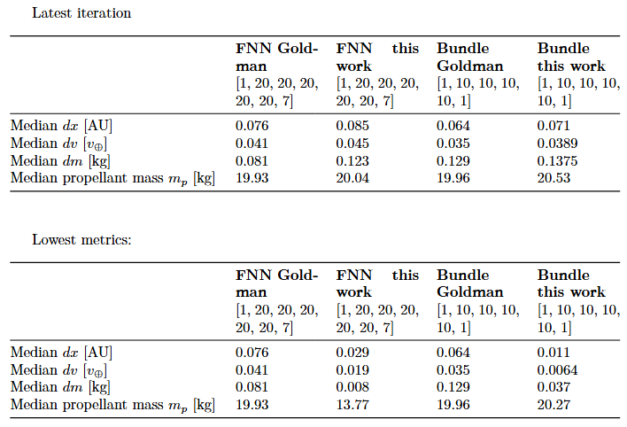
Verification & Validation
Metrics
Median values comparison

Slide 19
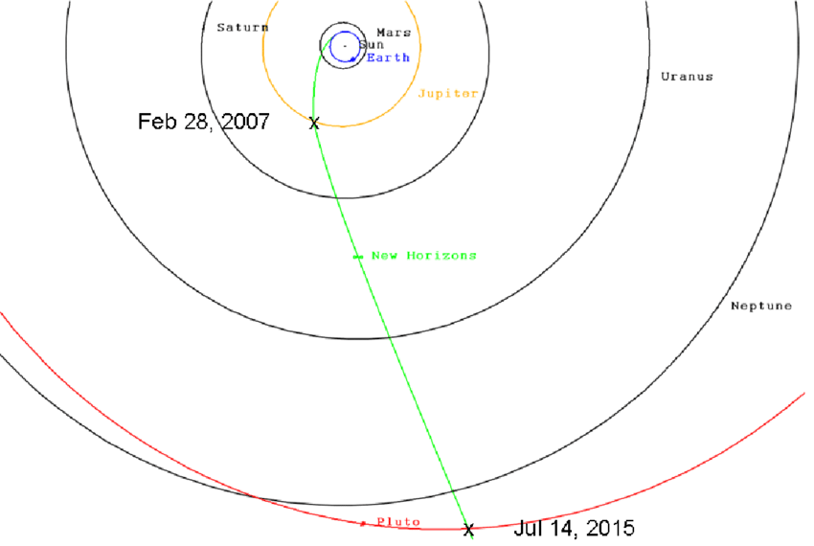
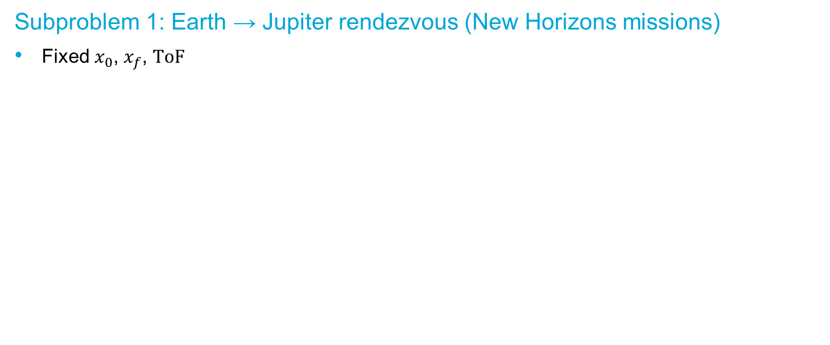
Pre-liminary results subproblem 1
Subproblem 1: Earth → Jupiter rendezvous (New Horizons missions)
Subproblem 1: Earth → Jupiter rendezvous (New Horizons missions)
Fixed $x_{0}$, $x_{f}$, $ToF$

Slide 20
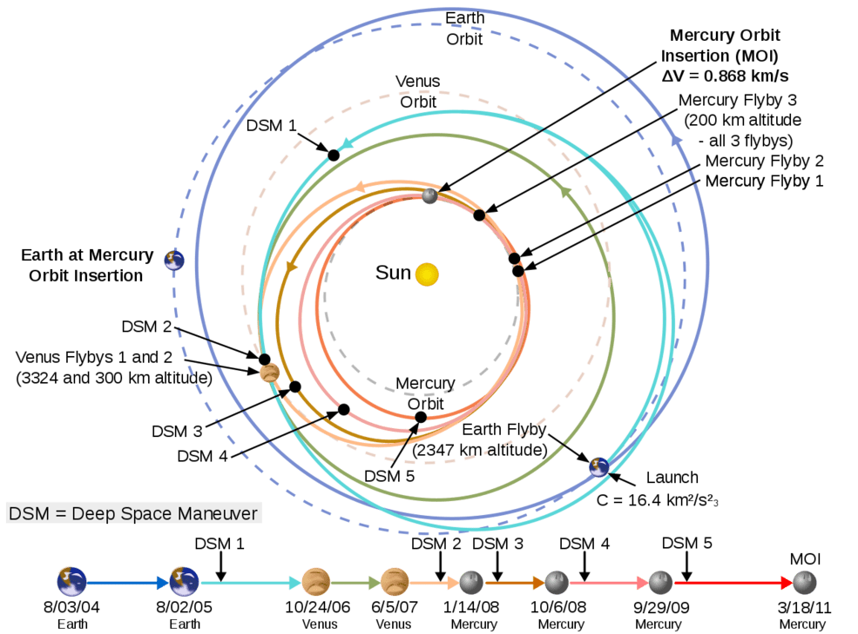
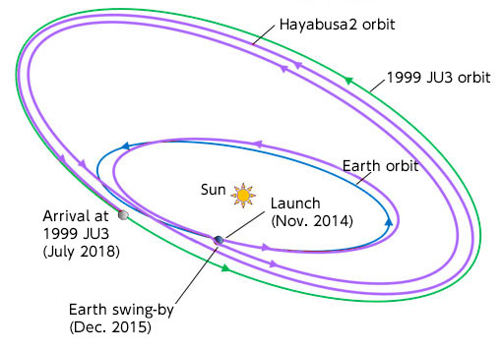
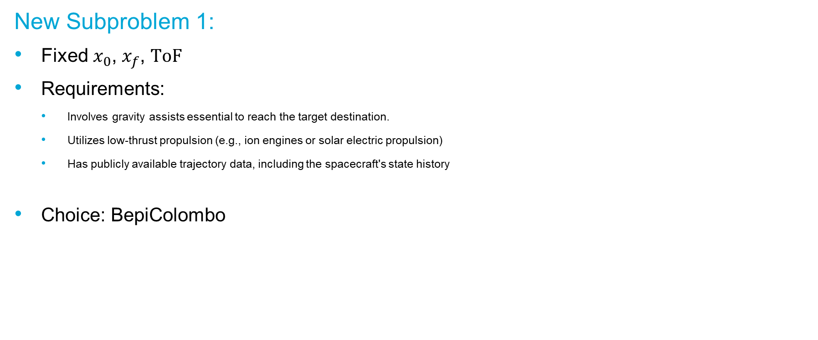
Pre-liminary results subproblem 1
BepiColombo
New Subproblem 1:
Fixed $x_{0}$, $x_{f}$, $ToF$
Requirements:
Involves gravity assists essential to reach the target destination.
Utilizes low-thrust propulsion (e.g., ion engines or solar electric propulsion)
Has publicly available trajectory data, including the spacecraft's state history
Choice: BepiColombo
Hayabusa2

Slide 21
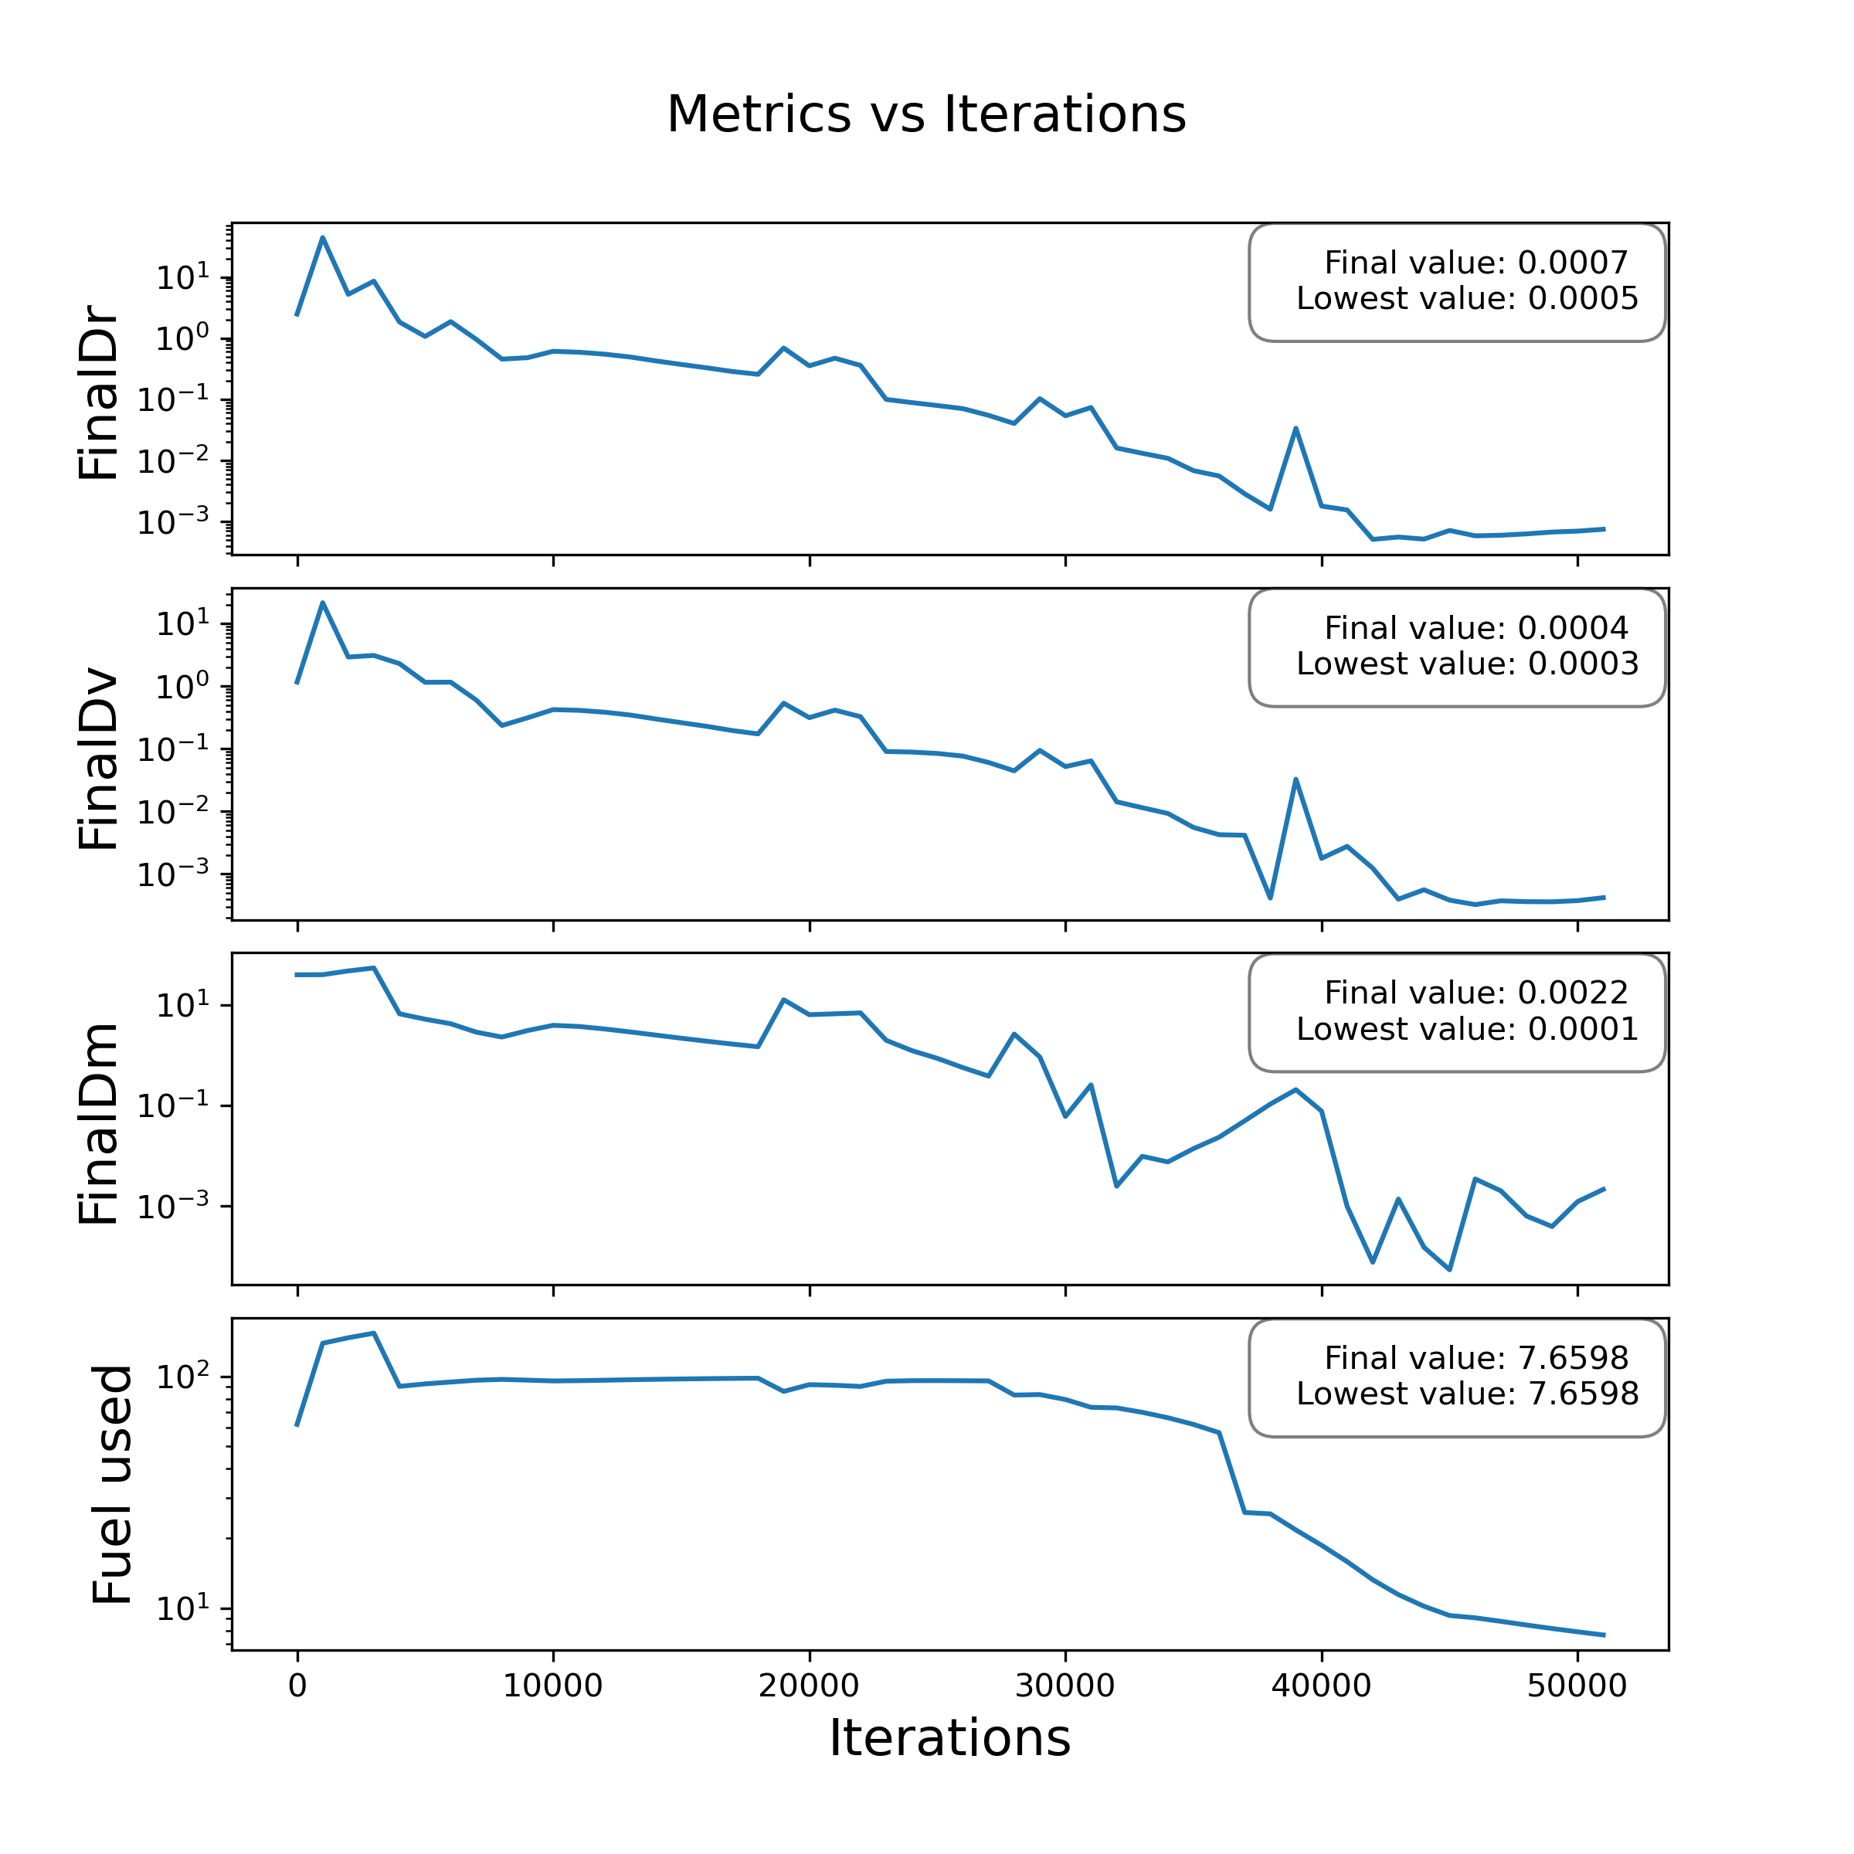
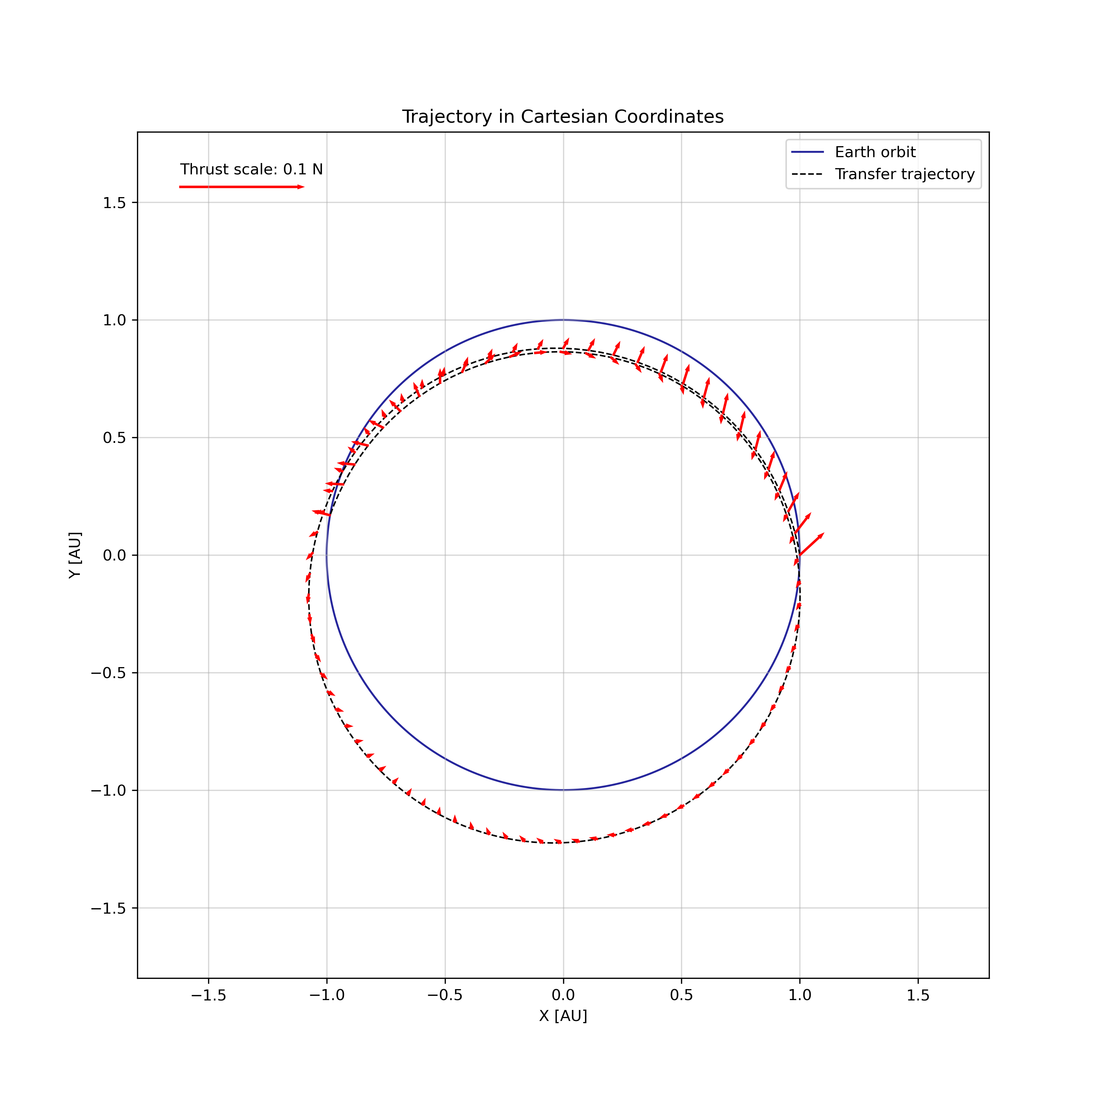
Pre-liminary results subproblem 1
Subproblem 1: Earth → Earth rendezvous
Trajectory leg 1

Slide 22
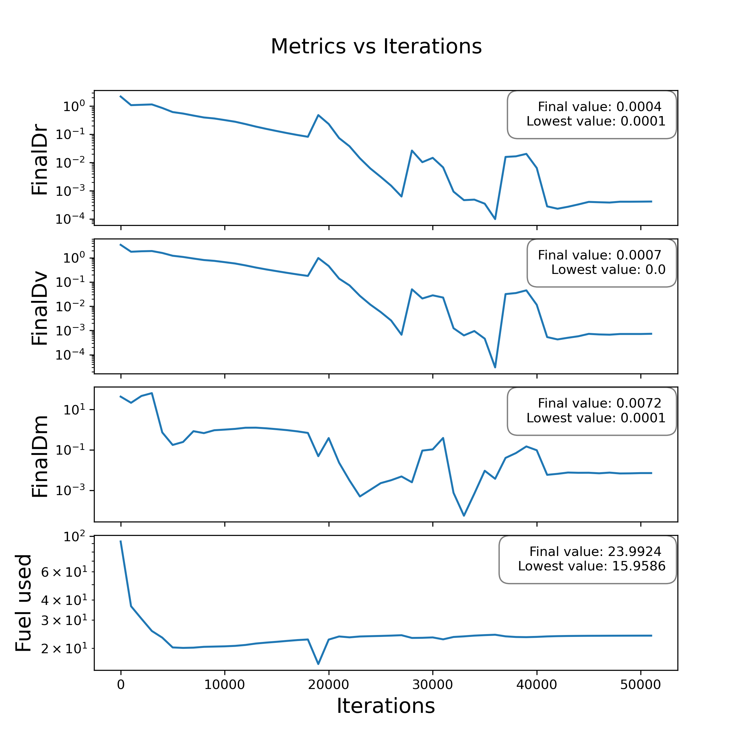
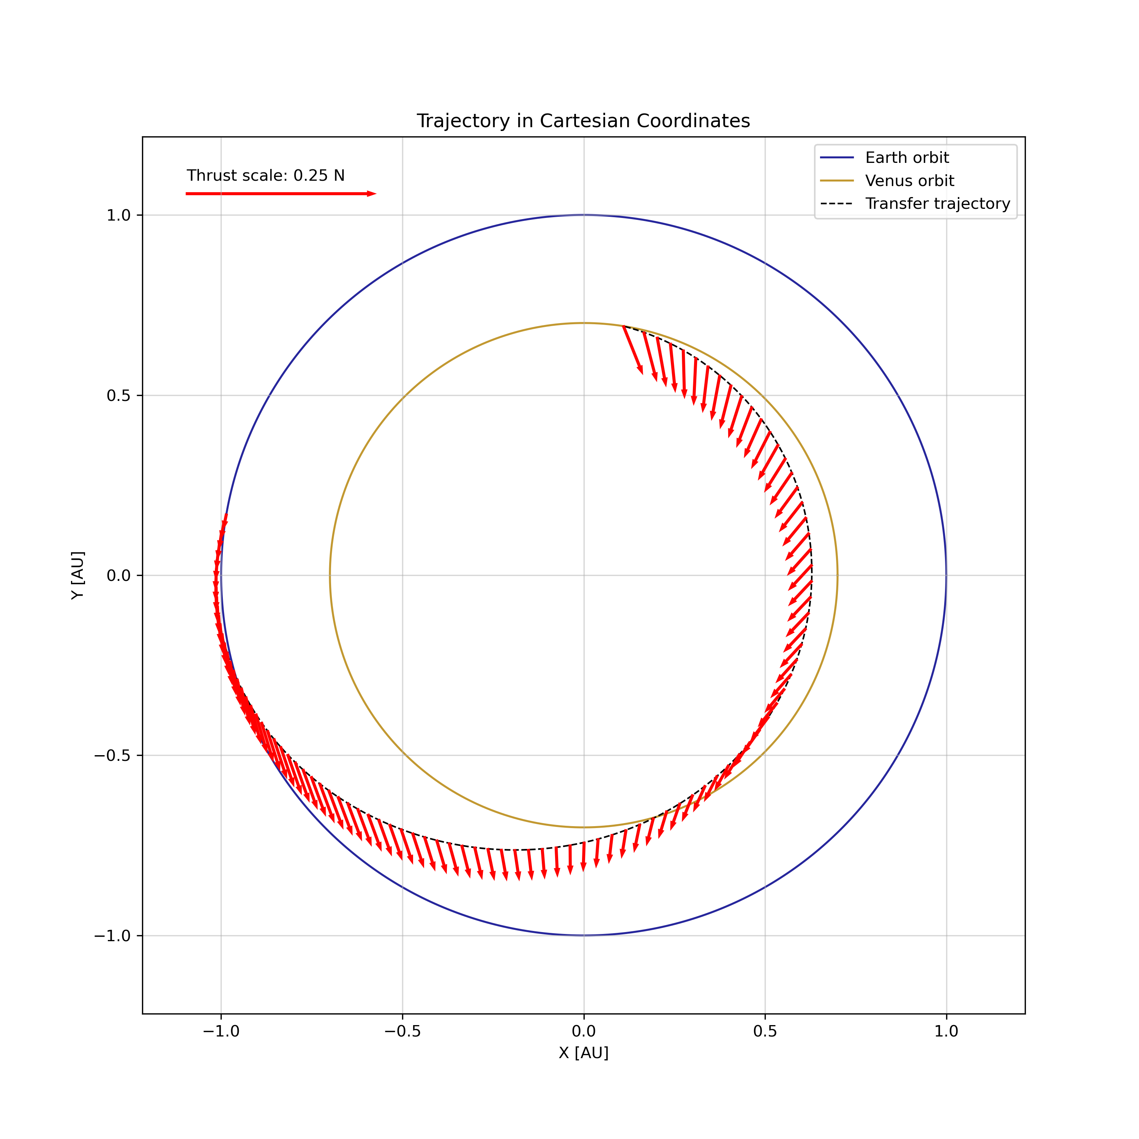
Pre-liminary results subproblem 1
Subproblem 1: Earth → Earth rendezvous
Trajectory leg 2

Slide 23
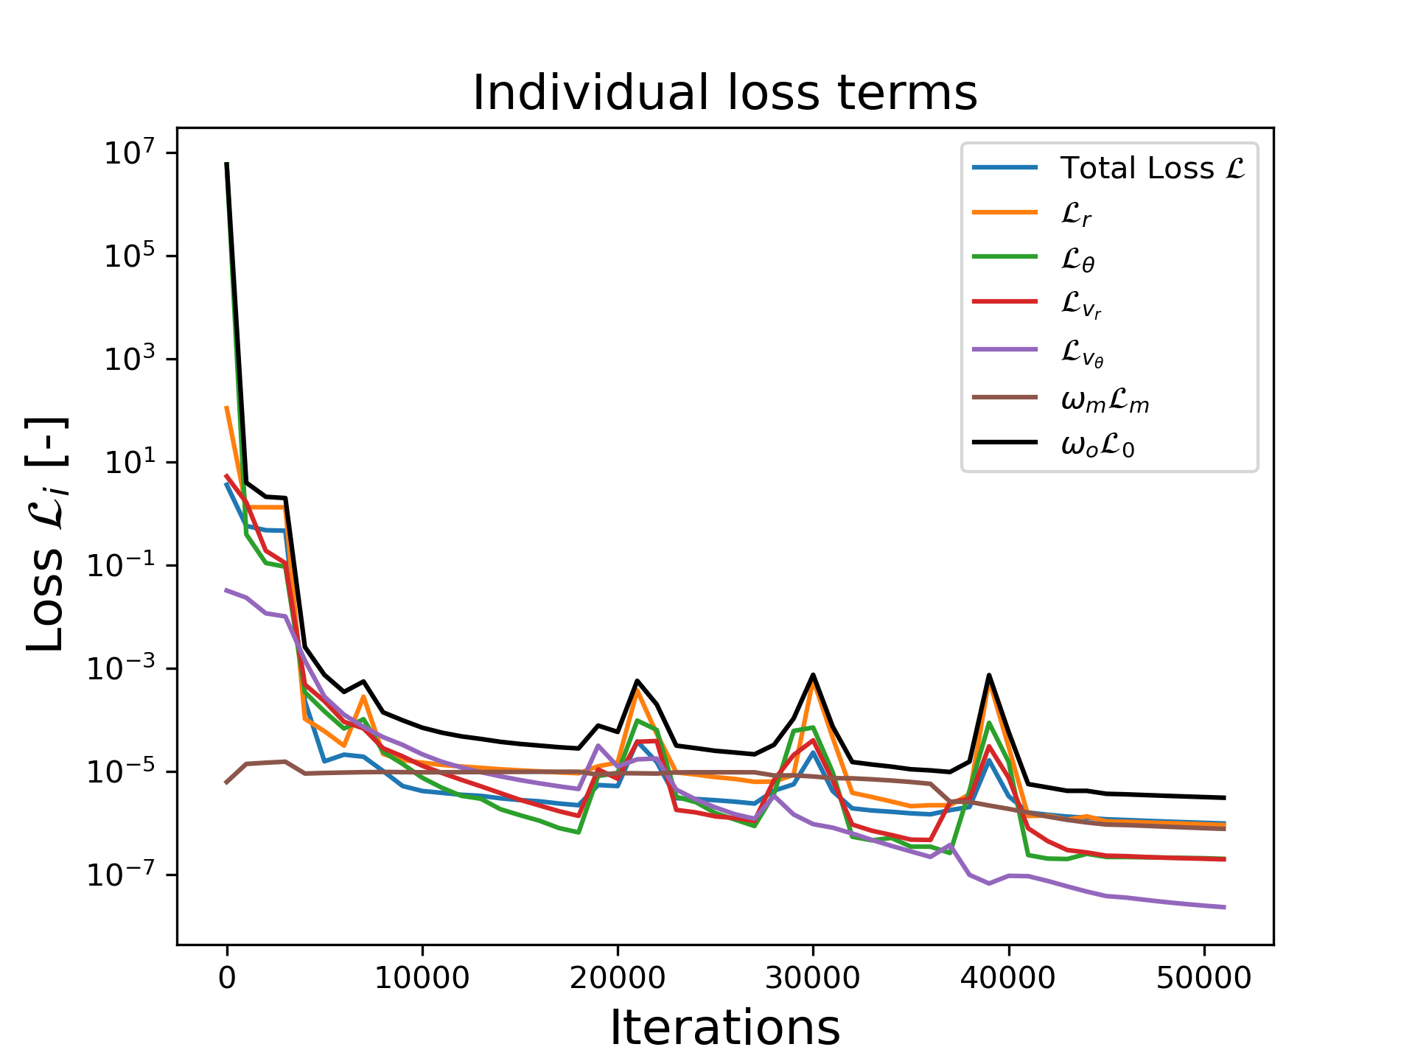
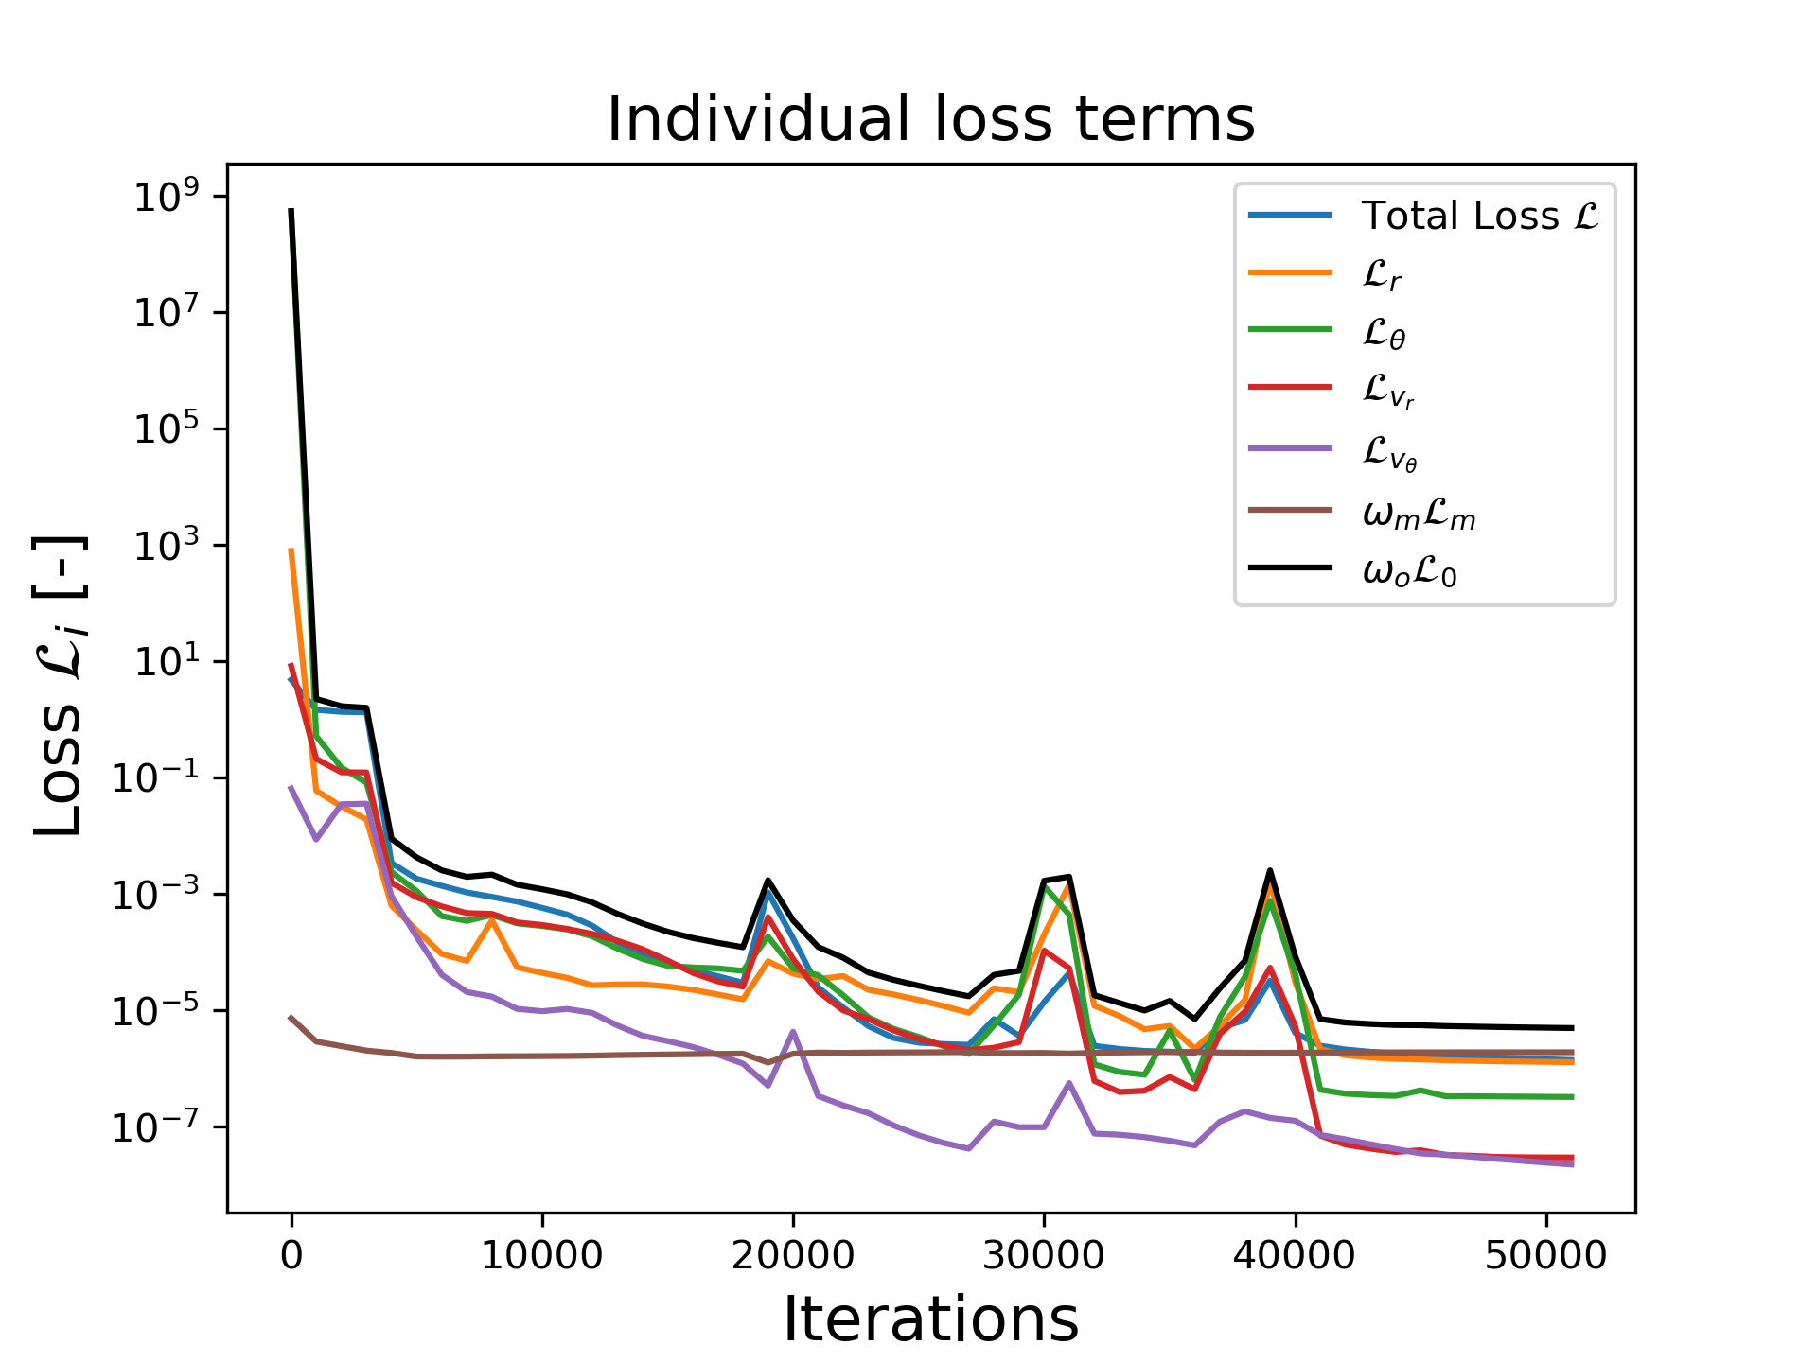
Pre-liminary results subproblem 1
Subproblem 1: Earth → Earth rendezvous
Loss evolutions
Leg 1 Leg 2

Slide 24
Chapter | dark mode
00
Analysis and reflection of results
3

Slide 25
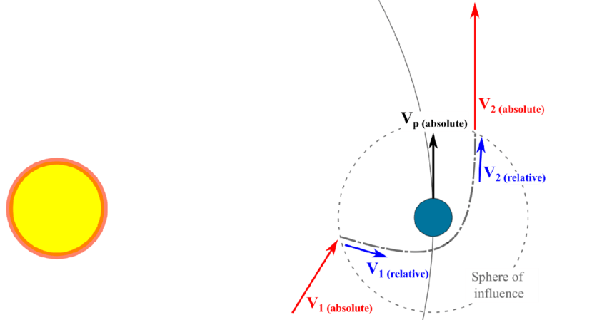
Analysis and reflection of results
Accuracy of the method

Slide 26
Analysis and reflection of results
Accuracy of the method
0.0001 AU = 15 000 km 0.0005 AU = 75 000 km 0.001 AU = 150 000 km 0.01 AU = 1 500 000 km
0.0640 AU = 9 600 000 km
SOI Earth = 924 000 km4,000km
SOI Jupiter = 48 200 000

Slide 27
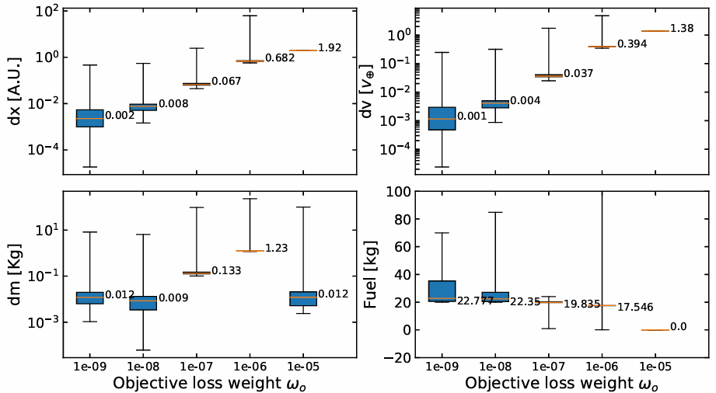
Analysis and reflection of results
Accuracy of the method
0.0001 AU = 15 000 km 0.0005 AU = 75 000 km 0.001 AU = 150 000 km 0.01 AU = 1 500 000 km
Fixes:
- Lower objective weight
- Try different activation function
0.0640 AU = 9 600 000 km
SOI Earth = 924 000 km4,000km
SOI Jupiter = 48 200 000

Slide 28
Analysis and reflection of results
Dependence on initialization of NN

Slide 29
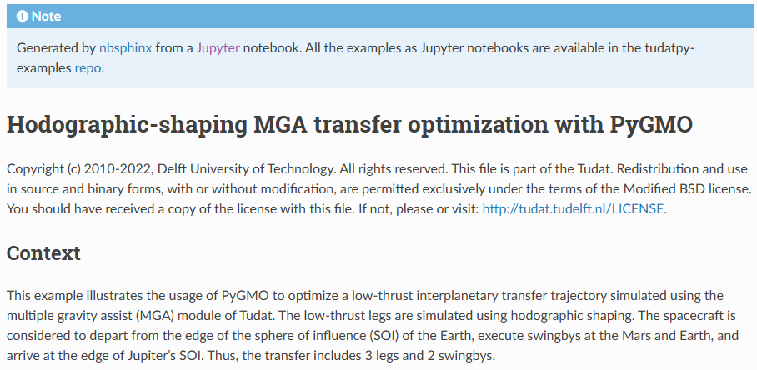
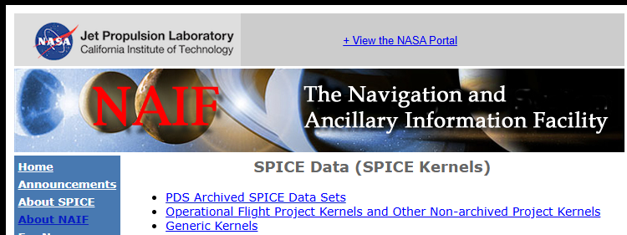
Analysis and reflection of results
V&V subproblem 1 + 2
Verification
Numerical integrations Tudat
Data BepiColombo
Validation
Hodographic shaping
Data BepiColombo?

Slide 30
Chapter | dark mode
00
Updated plan for remainder of thesis
4

Slide 31
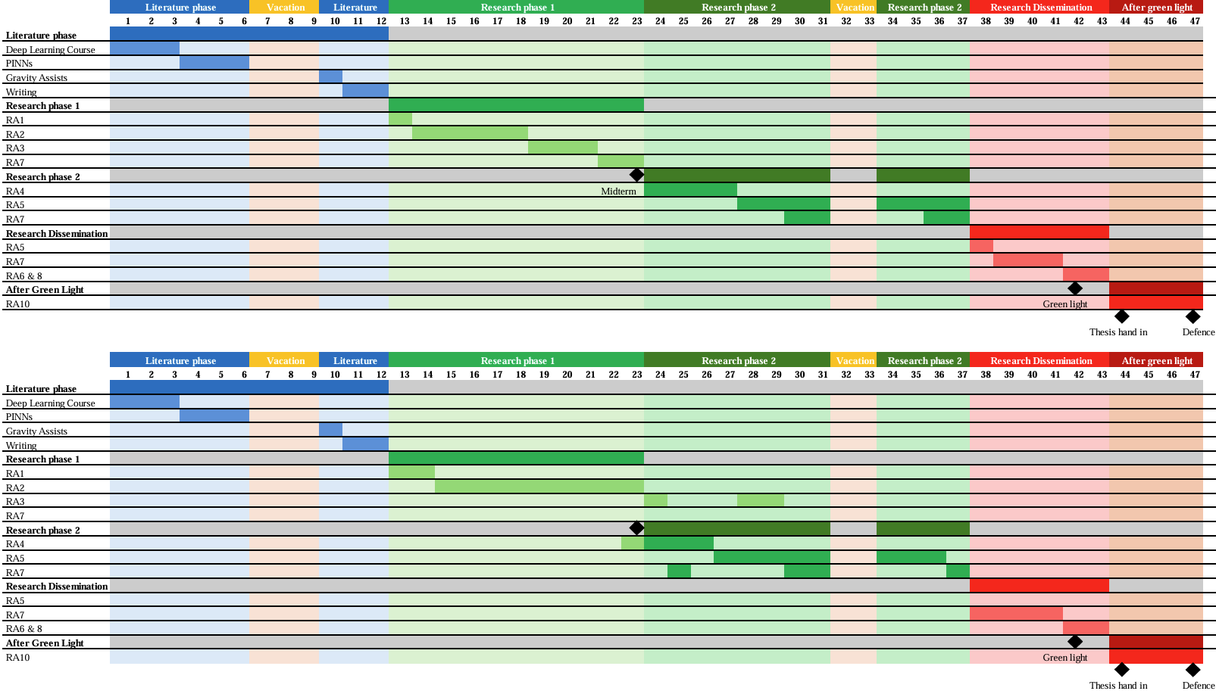
Updated plan for remainder of thesis

Slide 32
Chapter | dark mode
00
5
Q&A and Feedback

Slide 33
Q&A and feedback
Personal doubts/ points were I need feedback on:
Accuracy of solutions
Case scenario
V&V
Omit mass from output NN

Slide 34
Afsluiter
Thank you!

